Slide 1
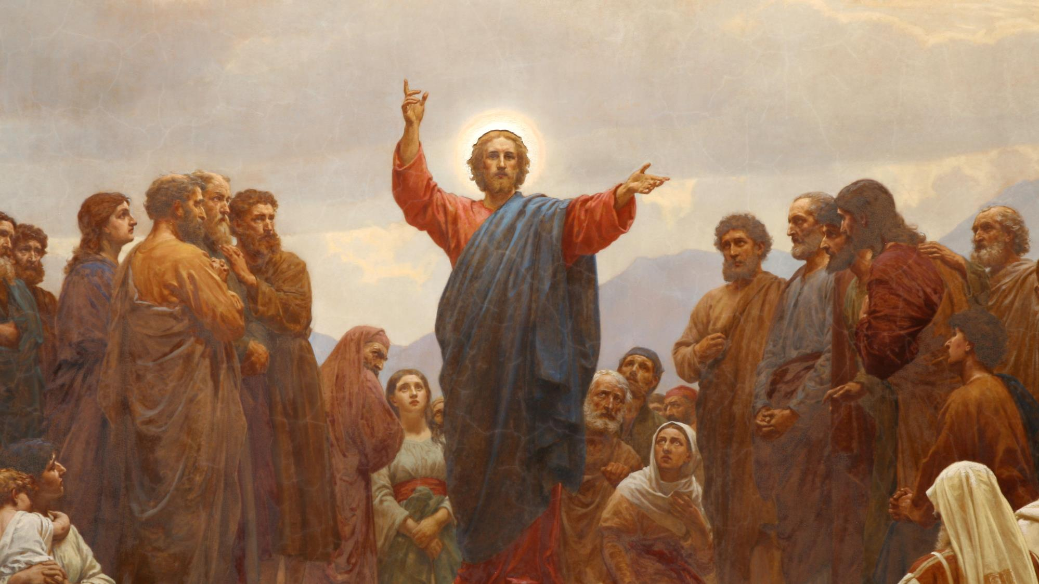
CALLED TO LOVE: THE ADVENTURE OF LIFE IN CHRIST
Topic: The Gift of the Law and the Call to Love God Above All- Old Law as Preparation for the Gospel –
The Twofold Commandment of Love - The Greatest Commandment - The First Three Commandments

Slide 2
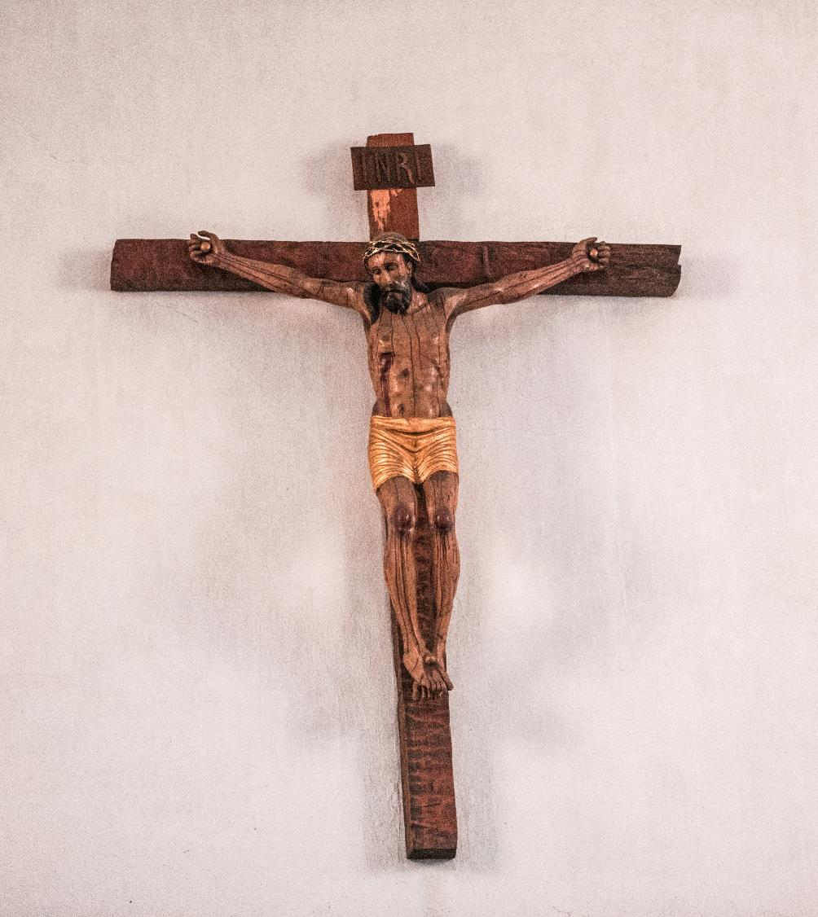
^{Opening Prayer}
Lord Jesus Christ,
we entrust our family to You and ask for Your blessing and protection.
We love You Lord Jesus with all our hearts, and we ask that You help our family to become more like the Holy Family.
Help us to be kind, loving, and patient with one another.
Give us all the grace we need to become saints and Your faithful disciples.
Amen.

Slide 3
^{Ice Breaker}
Speed Chatting
Families sit in two even rows, facing each other to form pairs.
Set a timer for two minutes.
Each person shares his/her favorite story about Jesus and explains why it’s his/her favorite.
When the time is up, people in one row each move one seat to the right (the person at the end of the line goes back around to the beginning).
Continue until all pairs have had a chance to chat. Adapted from www.weareteachers.com
This Photo by Unknown Author is licensed under CC BY-NC

Slide 4
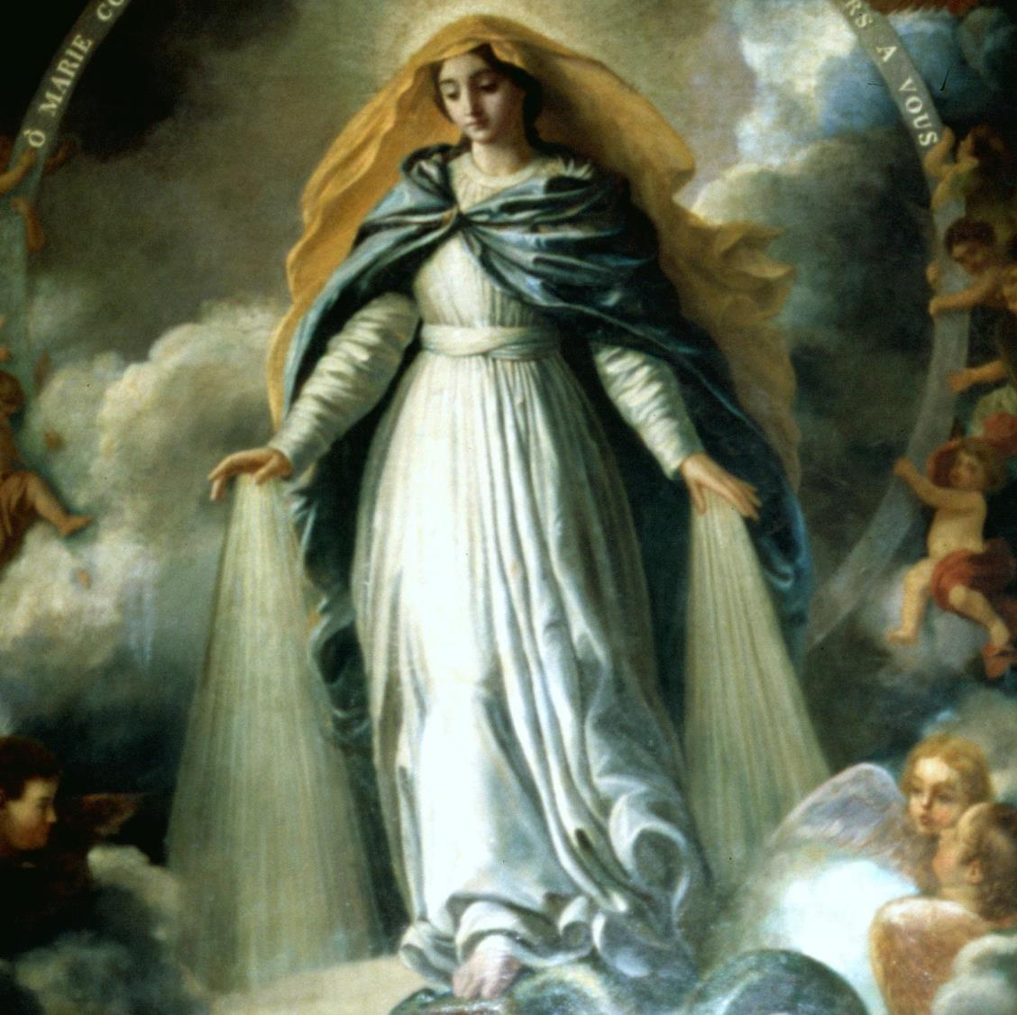
REVIEW
Last month we learned about God’s plan to save His family, and made a timeline of God’s family, beginning with Adam and Eve, God’s first children, all the way to the story of baby Moses.
Though God’s Chosen People made mistakes and sometimes made choices outside of God’s order of love, if they kept turning their hearts back to God, our spiritual ancestors grew in their faith along the way.
They carried Gods’ love for His family on the journey that would eventually lead to Mary’s Immaculate Conception, and through her to the birth of Jesus, our promised Savior!
This Photo by Unknown Author is licensed under CC BY

Slide 5
Today we are going to continue learning more about Moses and the Order of Love
that God the Father gave to His children, the Israelites, to live.
https://www.youtube.com/watch?v=Fg77AzAhSho

Slide 6
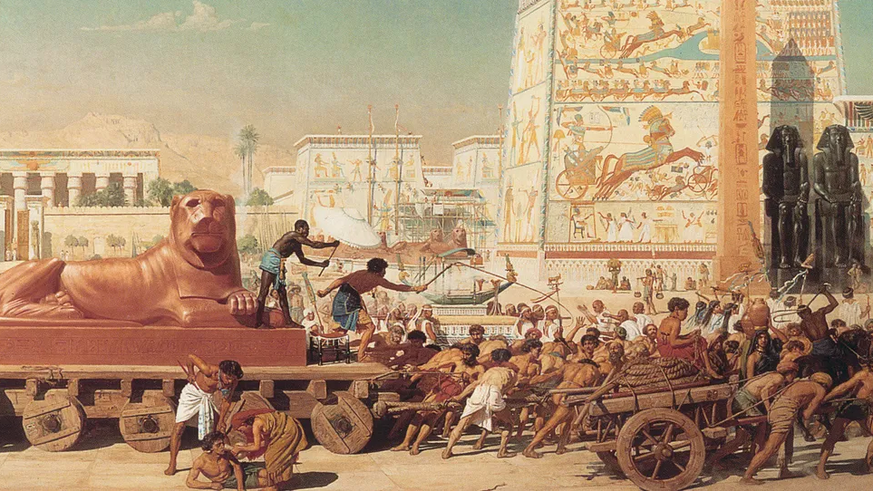

Slide 7
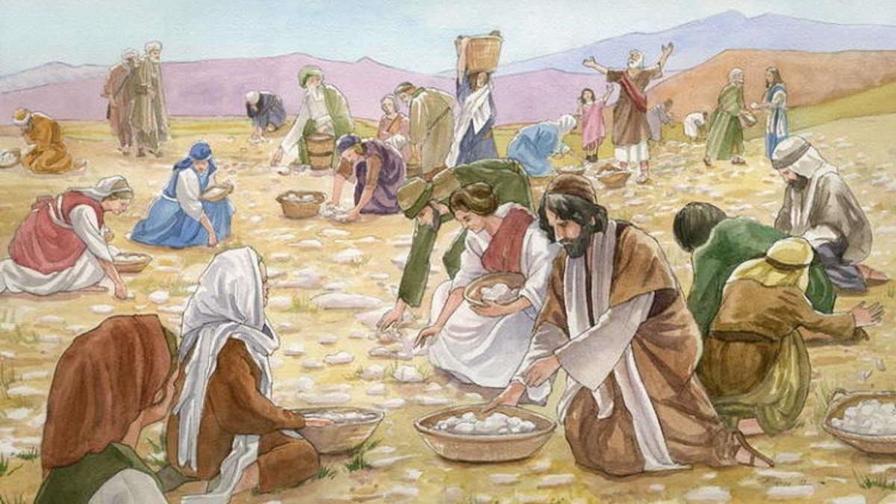

Slide 8
READ & WATCH: EXODUS 19:1-11
(Families can read along in their bibles as the video plays.)
Why would God appear to His children in such a frightening way?
https://www.youtube.com/watch?v=gCsGqbrL-1c

Slide 9
EXODUS 20:20
“Do not be afraid,
for God has come to you only to test you and put his fear upon you,
lest you should sin.”

Slide 10
Watch: The Golden Calf
God was loving and firm with His Chosen People in the same way that a parent would be to keep his/her toddler from touching something hot and injuring himself.
The Lord then made a covenant with the people. They were to keep His Laws and He would send His angel to protect and lead them. God promised them good health, happy families and a land of their own. In return, they would be His children and love and obey Him as their Father.
Then God called Moses to come up the mountain where He would give Moses two stone tablets with the Ten Commandments written on them.
https://www.youtube.com/watch?v=FBnJZ2s9_ns

Slide 11
LECTIO DIVINA
Sharing Guidelines:
Respectfully listening to each family member as he/she is sharing his/her reflection is very important.
Avoid interrupting or even correcting what another is saying (we’re looking to listen, not critique).
When each family member has had an opportunity to share, please wait quietly for the other families to finish while we wait for the other families to finish. Give families time to share privately.

Slide 12
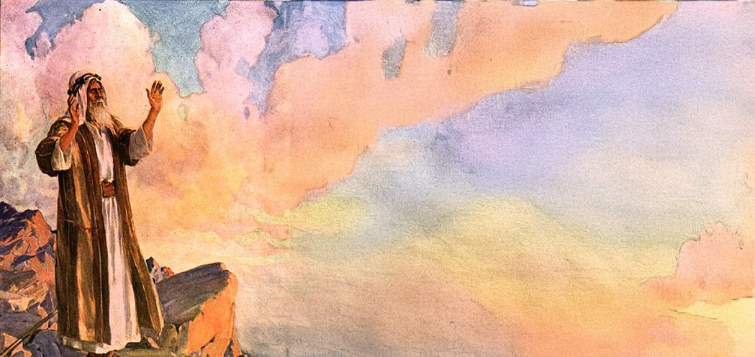
LECTIO DIVINA
All the family members to find a comfortable place to sit together as a small group.
God was very angry with the Israelites and told them that He would not be traveling with them to the Promised Land because they had chosen to worship the golden calf instead of their Heavenly Father who had rescued them from the slavery to the Egyptians.
Sit quietly as we pray and then continue to read the story of Moses’ Intimacy with God from Sacred Scripture. When I have finished reading, we will sit in silence for a minute and think about what God is saying to us through this story.

Slide 13
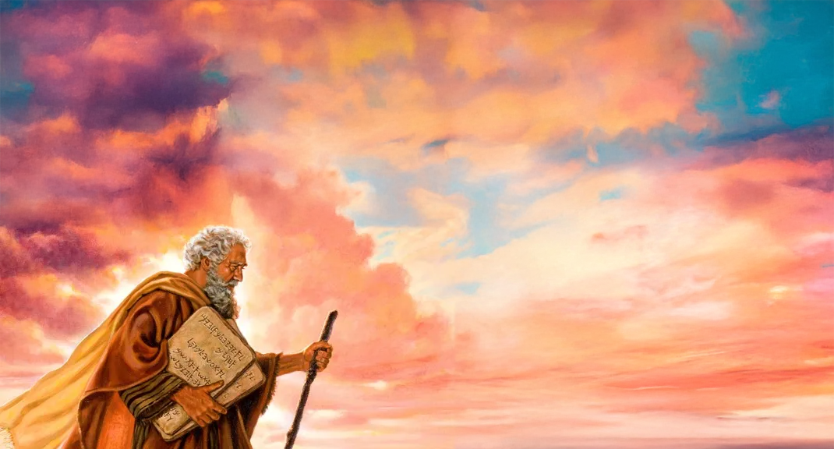
LECTIO DIVINA
Dear God, Our Father,
As we read and think about the story of
Your love for Your Chosen People, we ask the Holy Spirit to come and speak to the hearts of all here, from the oldest to the youngest.
Reveal to us Your Heart of love for us, Your children.
Read: Exodus 33:7-23 & 34:1-4

Slide 14
LECTIO DIVINA
As much as Moses wanted to see God, God wanted to be seen by Moses even more! God wants to be as close to His children as He possibly can because He is our Father and He loves us.
Sometimes our earthly fathers fall short and do not love as they should, but this is never true of God the Father. He created us for love, for God Himself is love!
What are some words that would describe the Heart of God the Father for His children?
What are some characteristics of God from this story?

Slide 15
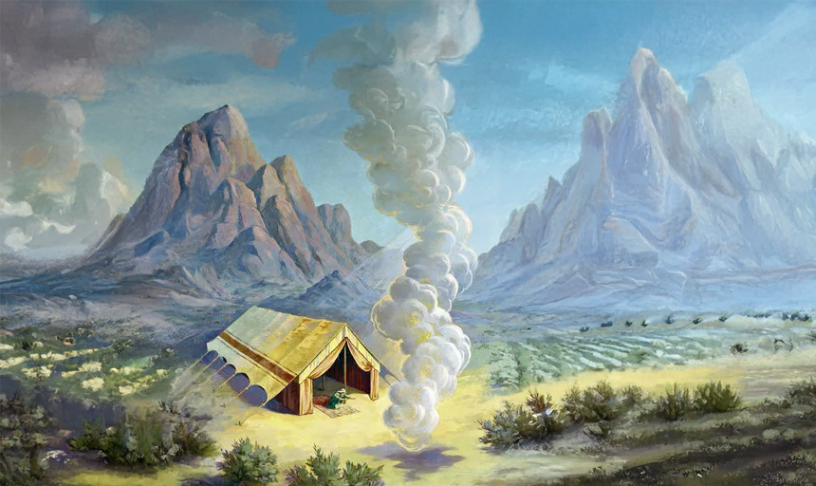
LECTIO DIVINA
This is how God describes Himself to us in
Exodus 34:5-7…
“Having come down in a cloud, the Lord stood with him there and proclaimed his name, ‘Lord’.
Thus the Lord passed before him and cried out, ‘The Lord, the Lord, a merciful and gracious God, slow to anger and rich in kindness and fidelity, continuing his kindness for a thousand generations, and
forgiving wickedness and crime and sin…’”
What words from this verse describing God the Father stand out to you?

Slide 16
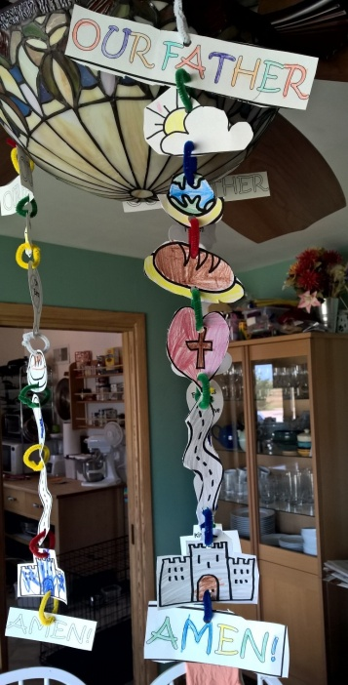
FAMILY ACTIVITY
This is the loving Father about whom Jesus taught us in the Lord’s prayer.
He still is our Father, who loves,
forgives,
and provides for us in our every need.

Slide 17
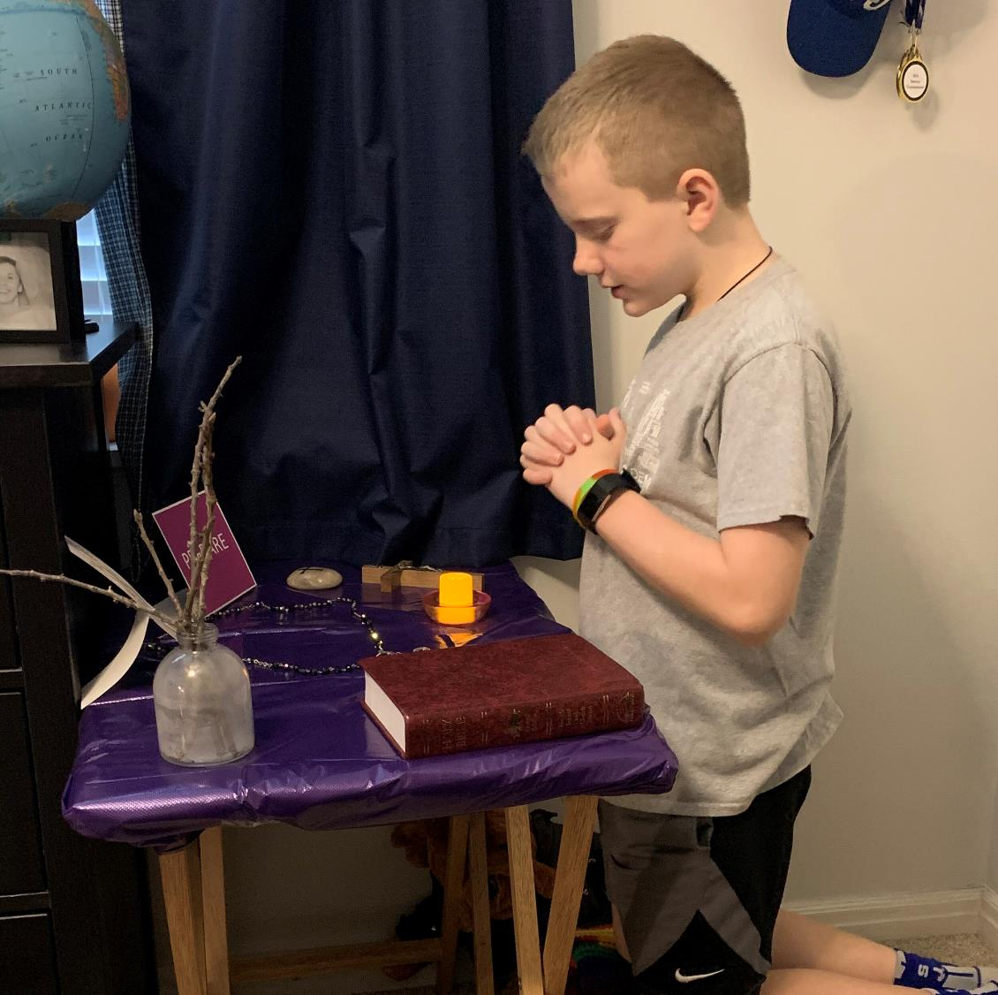
MISSION ACTIVITY
Your Family At-Home Mission is to:
Watch the videos about the Ten Commandments.
Gather around your Home Altar and say the Lord’s Prayer together as a family. Keep in mind that you are praying with Jesus!
Then, together as a family, mark the mantle of your front door with chalk and pray the Family Epiphany Blessing.
Be ready to share your Family Epiphany Blessing experience, as well as your front door mantle (take a picture) at Week 3’s gathering of families!

Slide 18
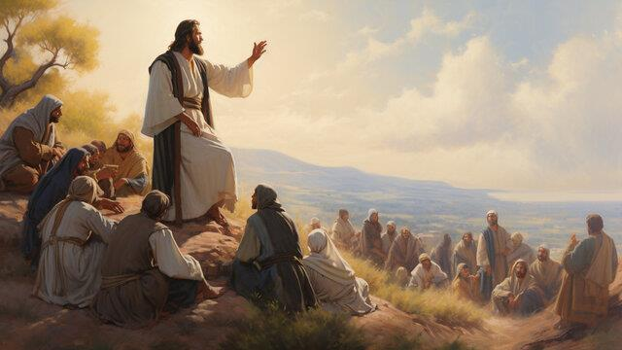
The Lord’s Prayer
Our Father, who art in heaven, hallowed be thy name; thy kingdom come; thy will be done on earth as it is in heaven.
Give us this day our daily bread; and forgive us our trespasses as we forgive those who trespass against us; and lead us not into temptation, but deliver us from evil. Amen

