Slide 1
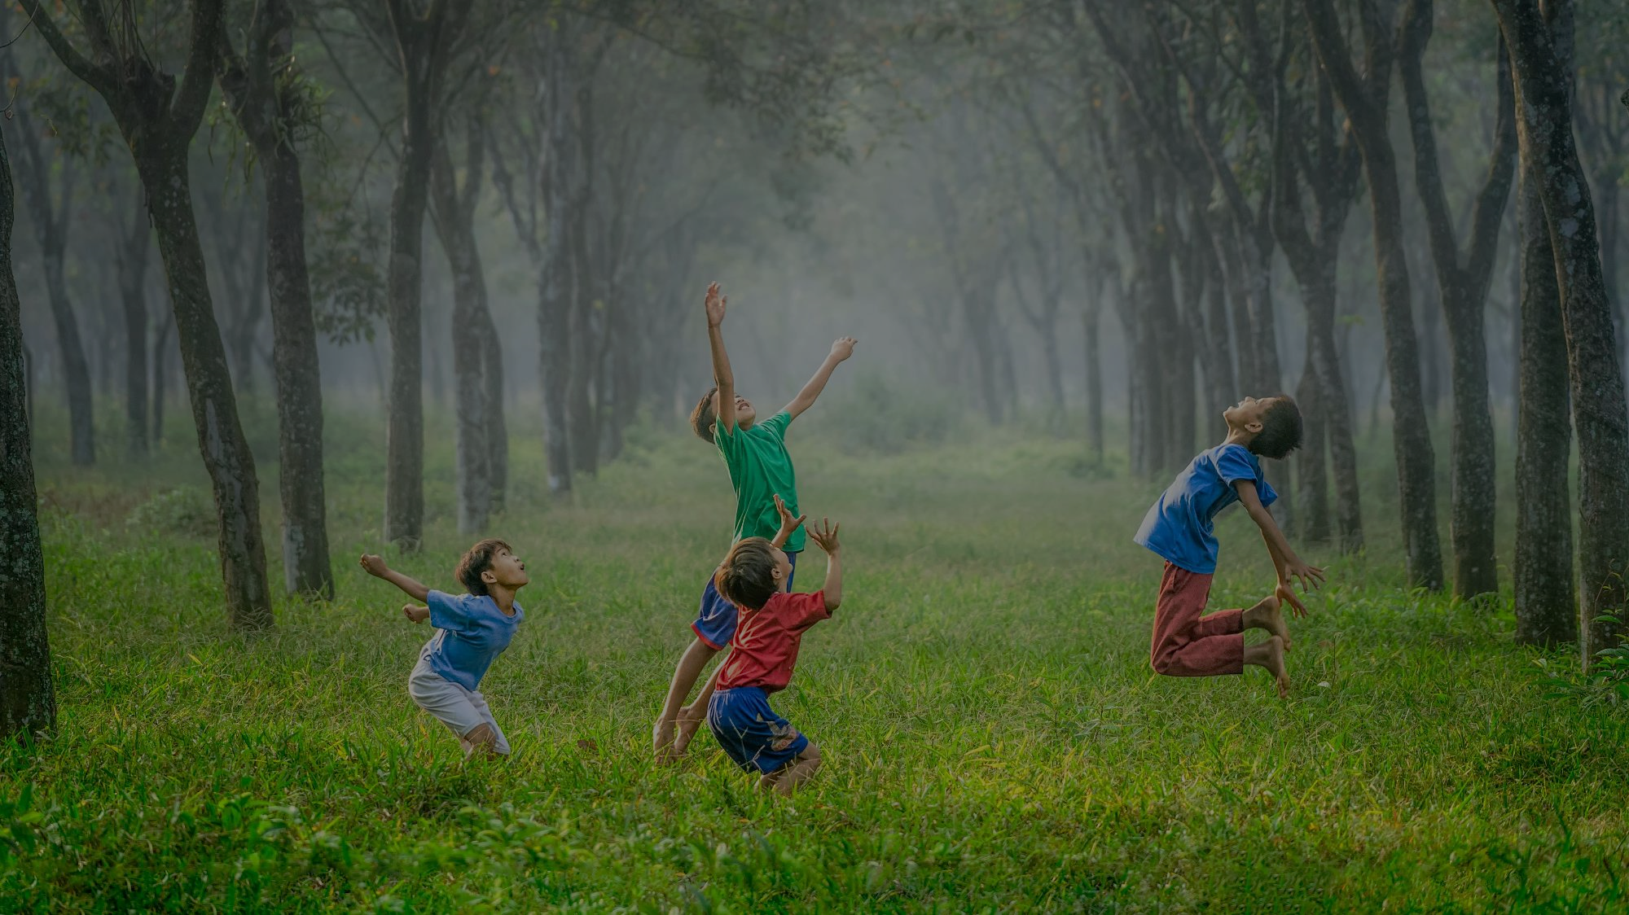
YEAR FIVE: CALLED TO LOVE
WELCOME SESSION JUST FOR PARENTS

Slide 2
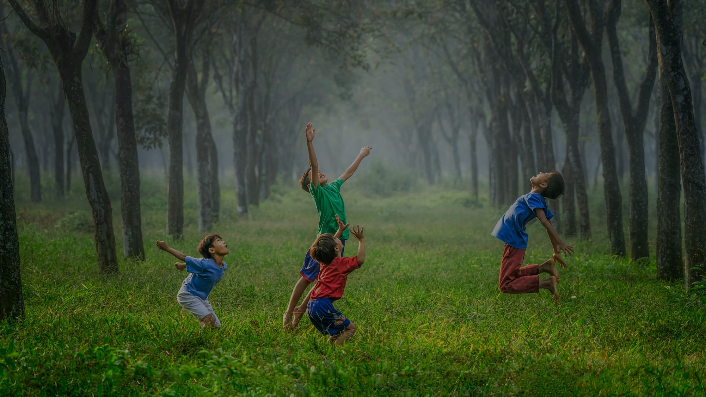
In this session we will share the vision for this year:
THE ADVENTURE OF LIFE IN CHRIST
CALLED TO MISSION: CATHOLIC PARENTING IN A POST-CHRISTIAN WORLD
STEPS TO NURTURING THE DOMESTIC CHURCH WELCOME SESSION JUST FOR PARENTS

Slide 3
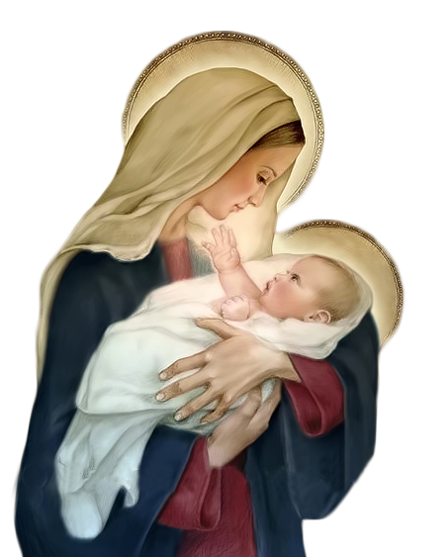
^{Opening Prayer}
Lord Jesus Christ, We entrust our family to You and ask for Your blessing and protection.
We love You Lord Jesus with all our hearts, and we ask that You help our family to become more like the Holy Family.
Help us to be kind, loving, and patient with
one another.
Give us all the grace we need to become saints and Your faithful disciples. Amen.
This Photo by Unknown Author is licensed under CC BY-NC

Slide 4
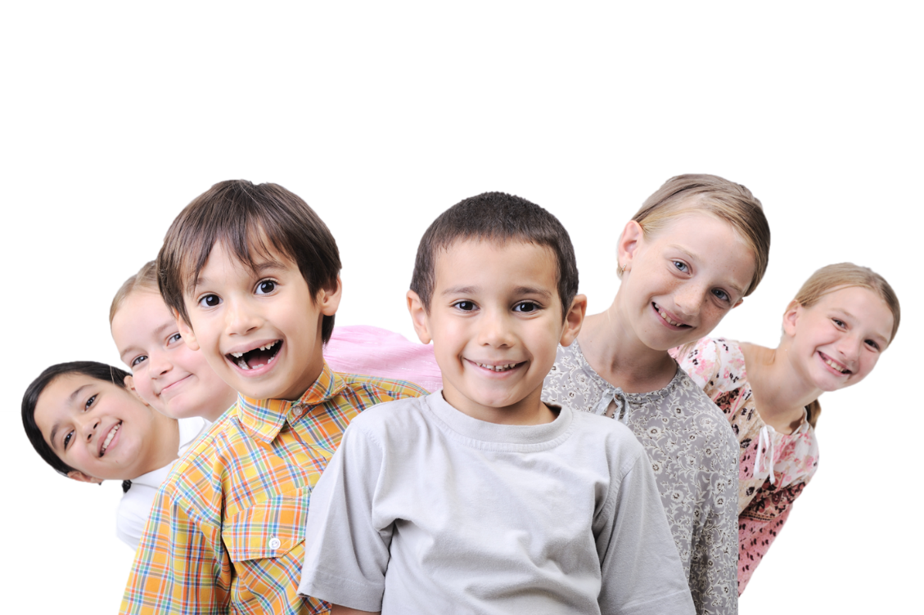
^{ICE BREAKER}
Parents will:
Introduce yourselves
Share how many children do you have and their ages/grade levels
Share how long you have been participating in Families Forming Disciples (FFD)
(Returning FFD families) Share what you like best about family faith formation, or how family faith formation has benefitted your family
(New FFD families) Share your hopes for how FFD can benefit your family
This Photo by Unknown Author is licensed under CC BY-NC

Slide 5
WHAT IS THE MISSION OF YOUR FAMILY?
Watch: The Catholic Family in a Post-Christian World | The Mission of the Family
https://www.youtube.com/watch?v=V2_fVfgVpRg

Slide 6
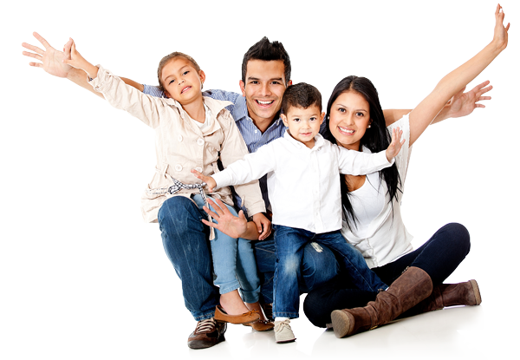
SMALL GROUP DISCUSSION
When you were growing up, what was your family life and the practice of faith like?
When you were growing up, how was the culture different than it is today?
Was God or faith the source of warmth in your home?
What challenges do parents and children face that are unique to today’s culture?

Slide 7
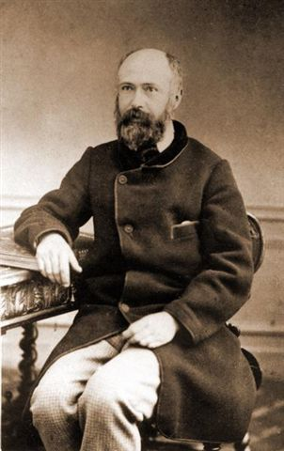
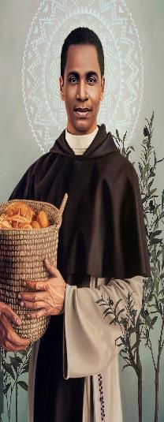
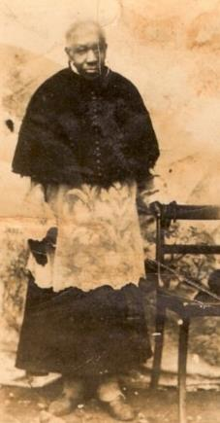
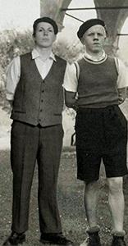
HOLY MEN AND WOMEN
St. Louis Martin
St. Martin De Porres
Bl. Francisco de Paula Victor
Bl. Lojze Grozde (right)

Slide 8
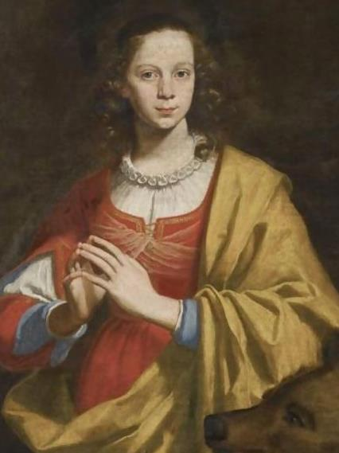
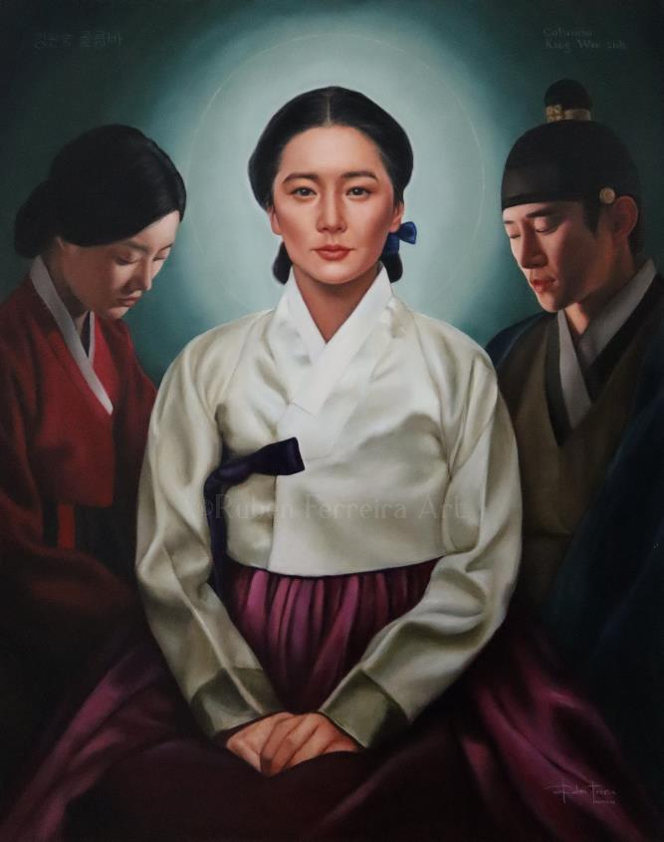
HOLY MEN AND WOMEN
St. Margaret of Cortona
Bl. Columba Kang Wan-suk

Slide 9
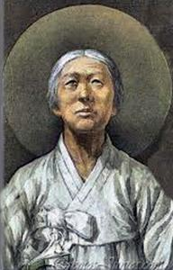
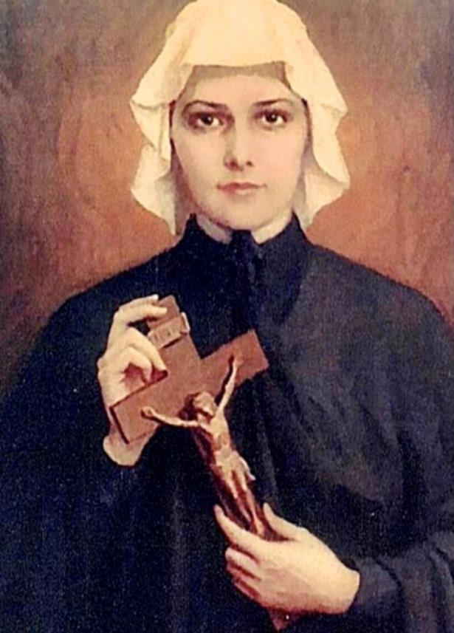
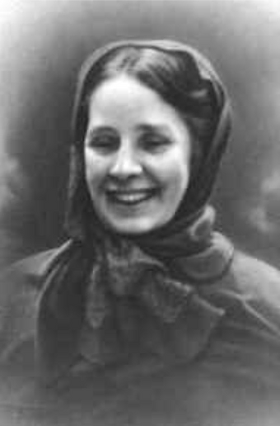
HOLY MEN AND WOMEN
St. Cecilia Yu So-sa
St. Elizabeth Ann Seton
Bl. Concepcion Cabrera de Armida

Slide 10
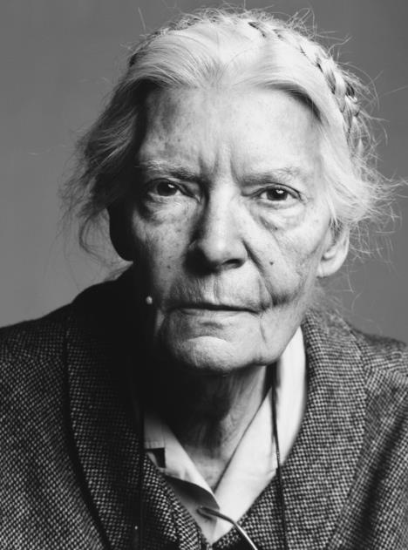
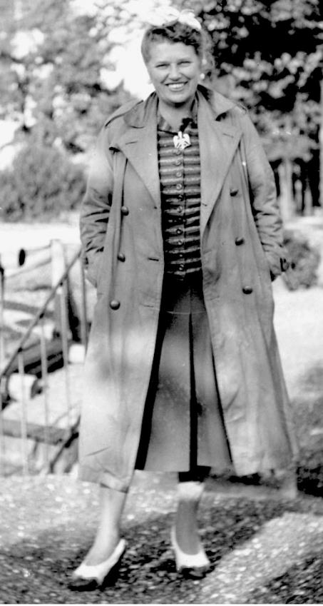
HOLY MEN AND WOMEN
Servant of God Dorothy Day
Servant of God Catherine Doherty

Slide 11
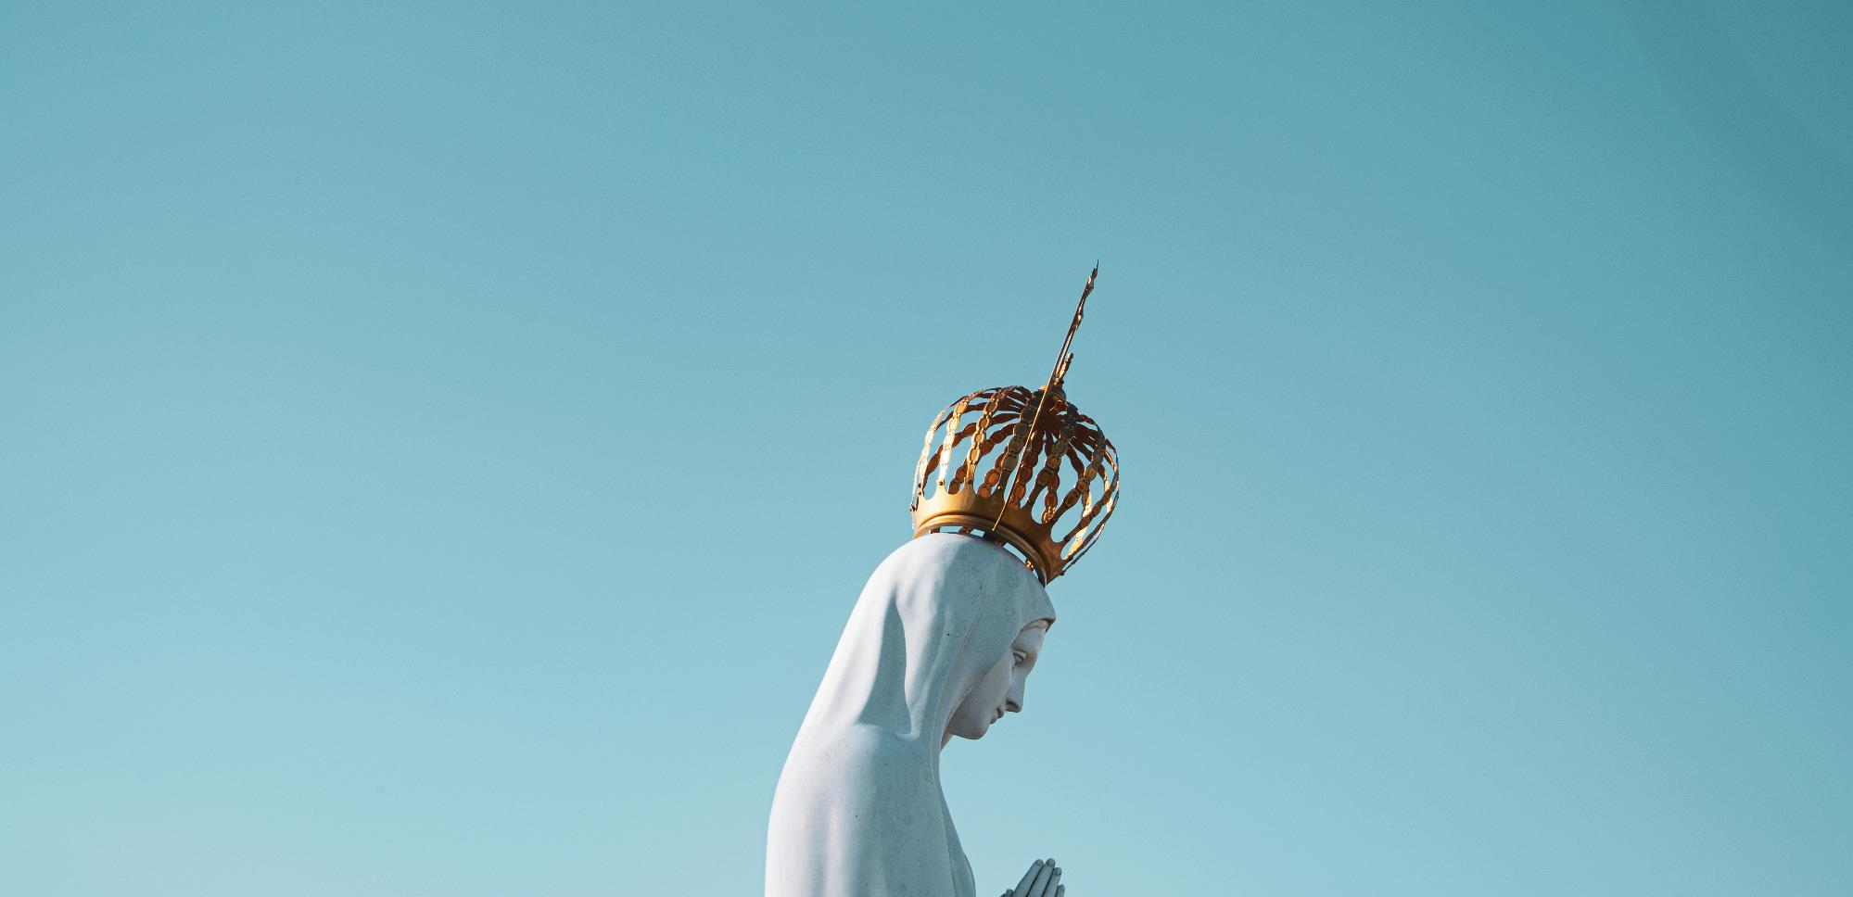
FAMILY LIFE
Although families can be very different, they are the same in one very important way. They are all called to holiness. Whether you are a single or married parent, your home is called to be a Domestic Church, a place where God is the source of warmth and love, and where faith thrives.
Name some ways that your family nurtures being a Domestic Church.
For example, do you eat together as a family?
Do you have moments of sharing, listening, forgiveness, healing?
Do you put special emphasis on the Liturgical Calendar, such as Holy Days and seasons?
Do you do service together as a family?
Do you pray together as a family before meals?
Do you go to Mass and/or Reconciliation/ Confession together as a family?
Do you play and laugh together?

Slide 12
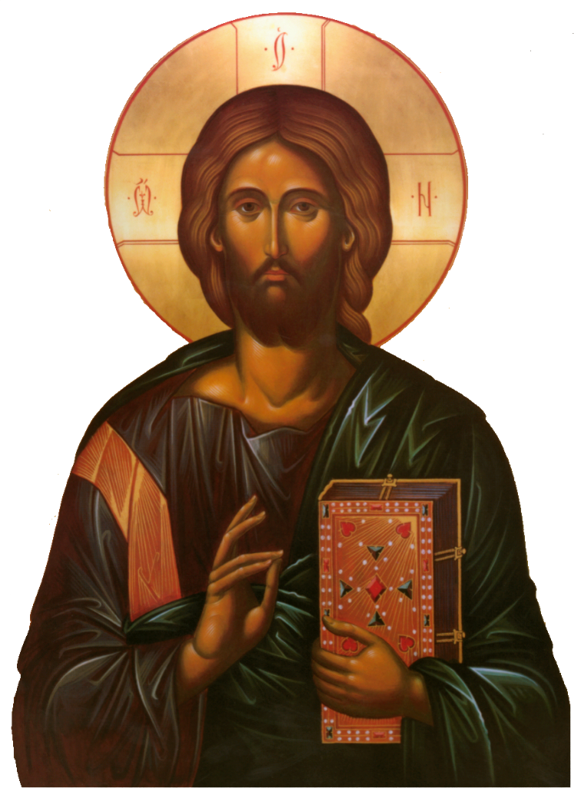
SMALL GROUP DISCUSSION
Discussion Questions:
How can you lead your family more intentionally to Jesus?
How can families support one another to live as disciples of Jesus?
How can your parish church better support your family to live as a Domestic Church?
When your children are grown and they look back at their childhood, how would you hope they will say they saw God’s grace and love in your home?

Slide 13
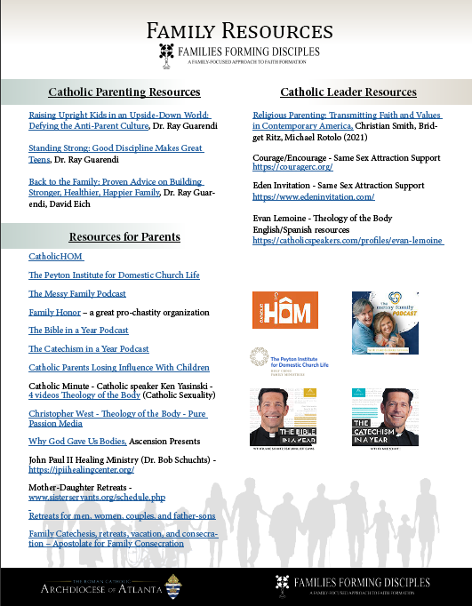
LIST OF RESOURCES

Slide 14
CLOSING PRAYER
“...But as for me and my house, we will serve the Lord.” (Joshua 24:15b)
Prayers for Your Family
Heavenly Father, we come before You as a family, seeking Your divine guidance. Help us to love and support one another, and may our family be a source of unity and strength. We ask for Your blessings and grace to be upon us always. Amen.
Adapted from www.christianity.com

