Slide 1
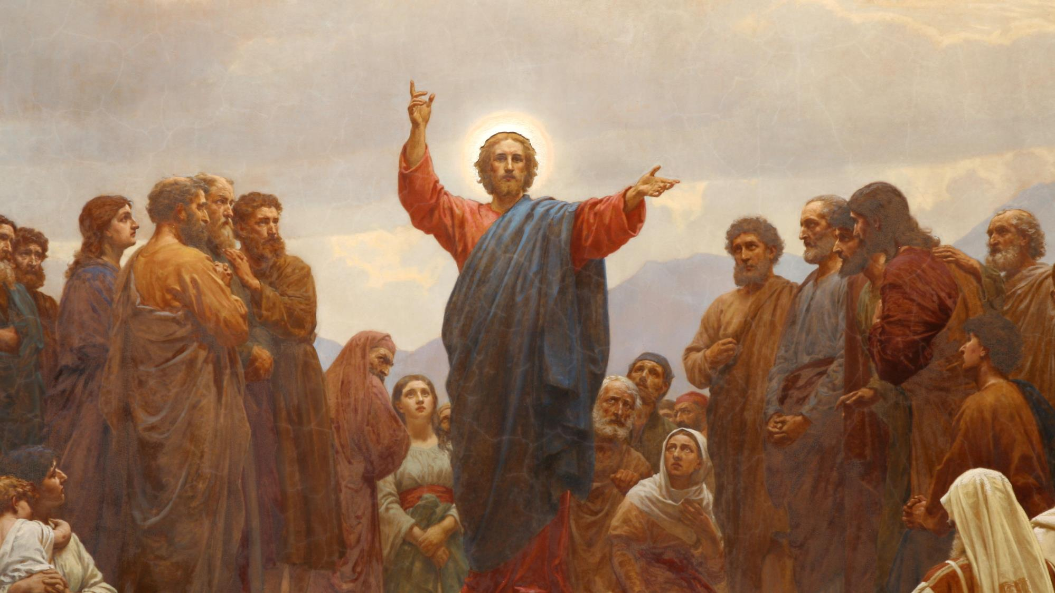
CALLED TO LOVE: THE ADVENTURE OF LIFE IN CHRIST
Topic: The Gift of the Law and the Call to Love God Above All- Old Law as Preparation for the Gospel –
The Twofold Commandment of Love - The Greatest Commandment - The First Three Commandments

Slide 2
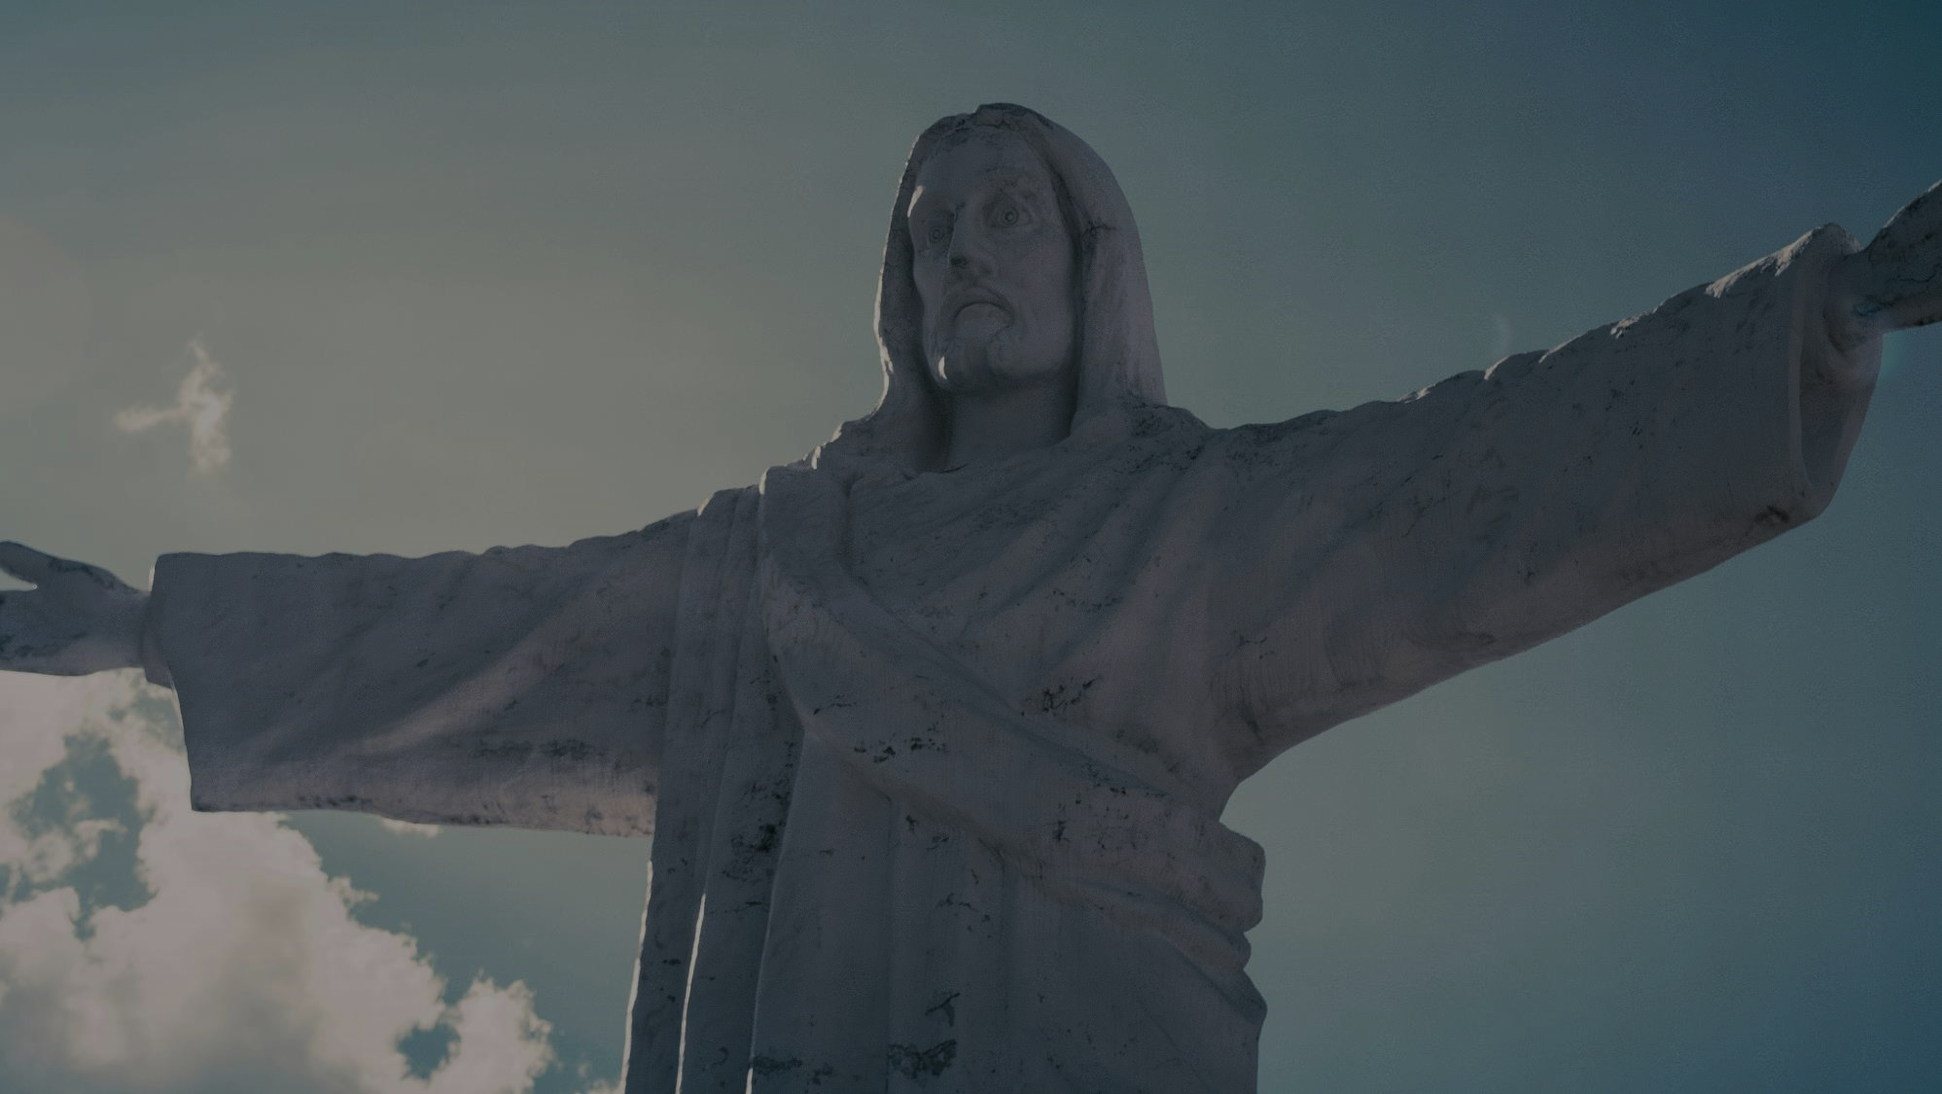
^{Opening Prayer}
Lord Jesus Christ,
We entrust our family to You and ask for Your blessing and protection.
We love You Lord Jesus with all our hearts, and we ask that You help our family to become more like the Holy Family.
Help us to be kind, loving, and patient with one another.
Give us all the grace we need to become saints and Your faithful disciples.
Amen.

Slide 3
^{Ice Breaker}
I AM BLESSED
Start with a volunteer and ask him/her to give reasons why he or she feels blessed.
Continue with each family member sharing how they are blessed until everyone has shared their blessings!
Close with a prayer thanking God for all the wonderful blessings that were shared.
Adapted from www.weareteachers.com

Slide 4
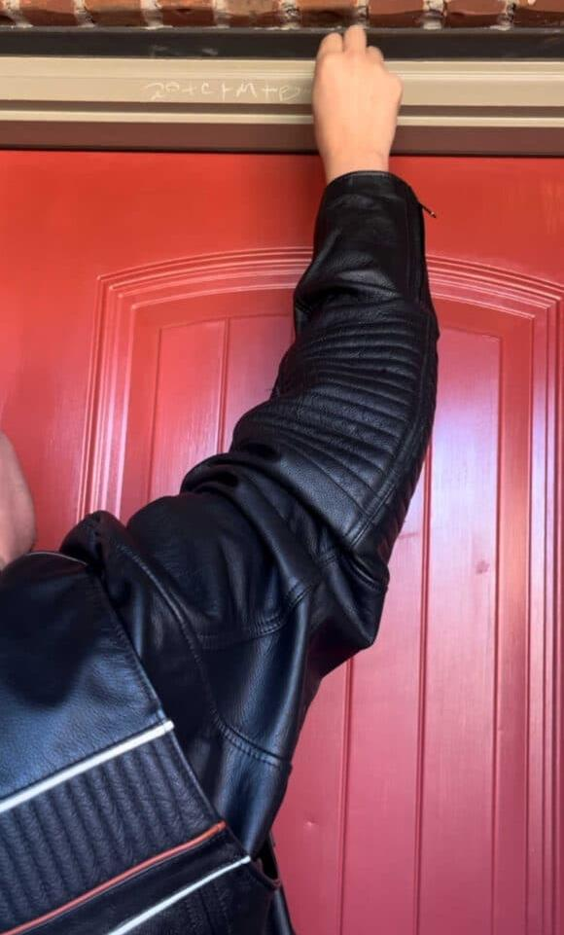
FAMILY EPIPHANY BLESSING
How would you describe your experience?
If you blessed your door last year, how was this year’s blessings different? Did anything stand out to you?
How did it make you feel, about your family, your home, yourselves?
What do you think of when you walk through the front door of your home?
What does the blessing mean to you?

Slide 5
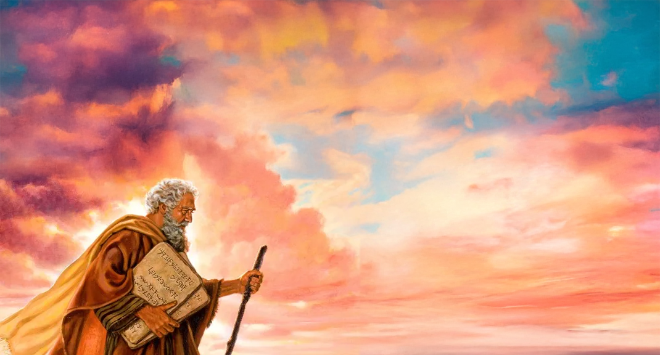
REVIEW
The last time we were together we learned that because of the long time that the Israelites had spent as slaves, they no longer knew how to be God’s children. They were an unruly society of people without any laws. They needed to be taught how to follow God, how to be His disciples. God’s laws or commandments would bring order that was necessary if they were going to become a new nation, a holy nation that was special to God!
God would have to start with teaching His children the basics of love. He would give them a twofold commandment of love, to teach them how to love God Himself as their Father, and how to love one another.
Later, when Jesus came to earth to save us, He would be asked about these laws or commandments.

Slide 6
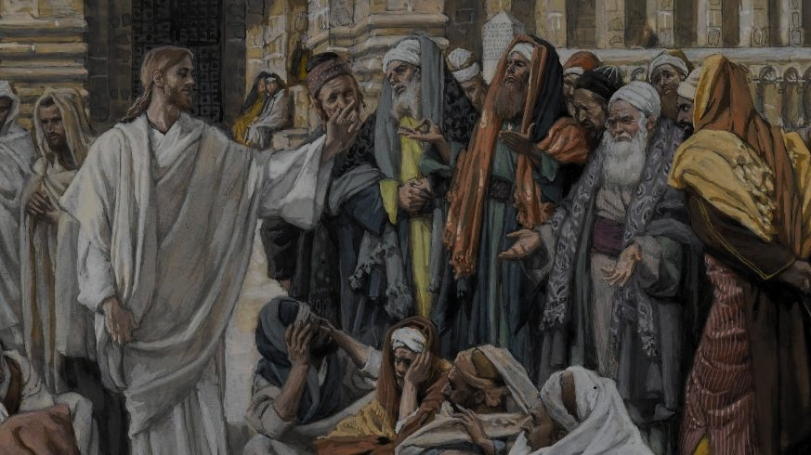
Open your bibles to Matthew 22: 34-40
Turn to Deuteronomy 6:4-9

Slide 7
THE TEN COMMANDMENTS
https://www.youtube.com/watch?v=NPxOCxsbzVQ

Slide 8
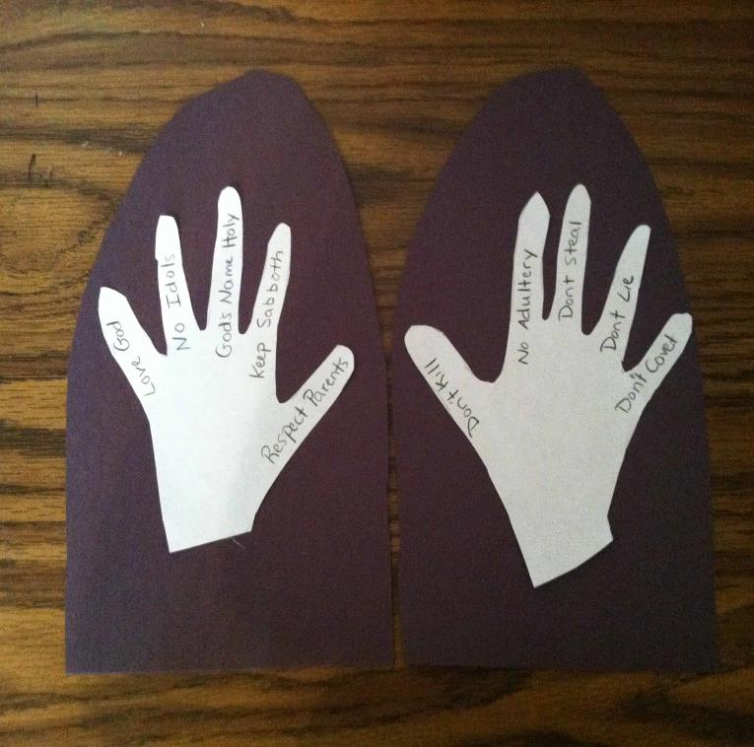
FAMILY ACTIVITY
Use the Ten Commandments listed in
Exodus 20
to make the
God gave Moses the
10 Commandments Bible Craft!

Slide 9
