Slide 1
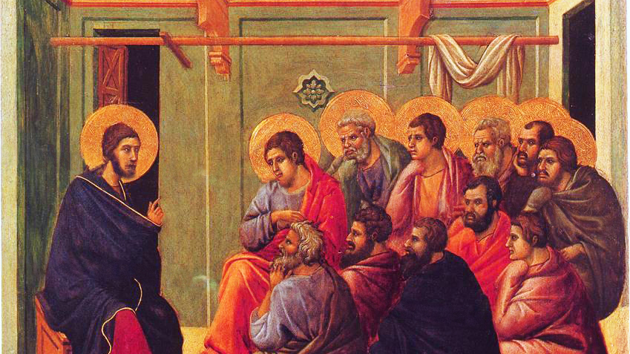
CALLED TO LOVE: THE ADVENTURE OF LIFE IN CHRIST
TOPIC: The Call to Love of Neighbor

Slide 2
^{Opening Prayer}
Lord Jesus Christ, we entrust our family to You and ask for Your blessing and protection.
We love You Lord Jesus with all our hearts, and we ask that You help our family to become more like the Holy Family.
Help us to be kind, loving, and patient with one another.
Give us all the grace we need to become saints and Your faithful disciples.
Amen.

Slide 3
^{Ice Breaker}
BUCKET LIST
1. Each family member gets a slip of paper and writes one or two activities that he/she would like to do this year.
2. Then he/she crumples it up and throws it into the bucket.
3. One person takes a crumpled paper out of the bucket, reads it to the group.
4. Everyone guesses who wrote the idea.
5. Repeat until all the bucket list ideas have been shared.
6. Families discuss which activities they will do together this year! Adapted from www.weareteachers.com

Slide 4
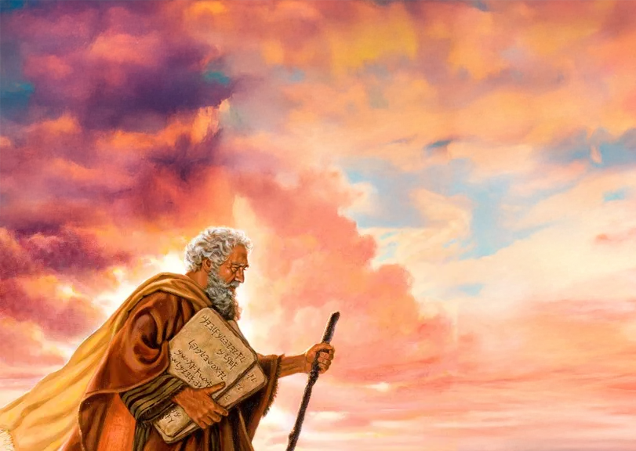
REVIEW
Last month, we learned that because of the long time that the Israelites had spent as slaves, they no longer knew fully how to be God’s children. They struggled to love God and one another. In many ways they were an unruly society of people without any laws.
The Israelites needed to be taught how to follow God, how to be His family. God’s laws, or commandments, would bring order and freedom that were necessary if they were going to become a new nation, a holy nation that was special to God, a nation that was His own family!

Slide 5
REVIEW
God would start by teaching His children the basics of love. He would do this by giving them laws to follow based on the natural moral law. Laws or precepts based on the natural law are ones that all people can understand if we use our reason (i.e., right reason).
Because human beings are made in the image and likeness of God, destined to be His children, we have the ability to use reason to discern right and wrong, which is the basis for morality. Because of sin, we often need the help of God’s mercy and grace to align our reason with what is true, good, and beautiful.

Slide 6
WATCH: The Ten Commandments: God’s Law of Love
https://www.youtube.com/watch?v=hZnzyr43nzI

Slide 7
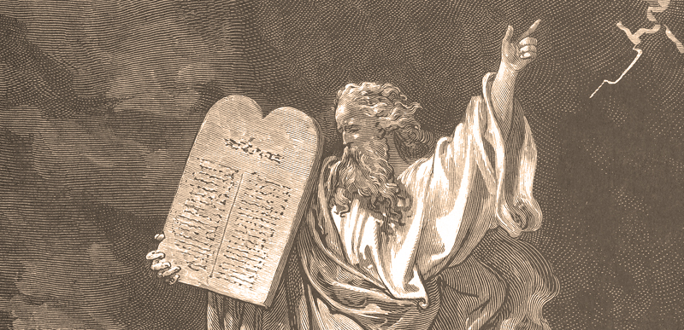
READ: Exodus 20:1-17
_____________________________
I am the Lord your God;
you shall not
have strange gods before me.
_______________________________
Make a list of special things you have displayed in your homes that show who you are.
For example: Do you have sports or music posters, pictures of family members or friends?

Slide 8
READ: Exodus 20:1-17
_____________________________
I am the Lord your God;
you shall not
have strange gods before me.
_______________________________
Now list special or holy items that you have in your home that show
who your family is as children of God.
What in your home shows that your family keeps the First Commandment by loving God who created us and loves us?
What shows that God has first place in your family life? Adapted from www.catechist.com

Slide 9
MISSION ACTIVITY
Your Family At-Home Mission is to:
Watch the videos about the Ten Commandments
Choose a special or holy item from your home that shows who your family is as children of God and that your family keeps the First Commandment by loving God who created us and loves us.
Bring that item or a picture of the item to share at the Week 3 gathering.
Consider going to the Sacrament of Reconciliation as a family to receive grace to live God’s laws of love!
Gather as a family around your home altar and thank God for loving your family by praying a decade of the Rosary.

Slide 10
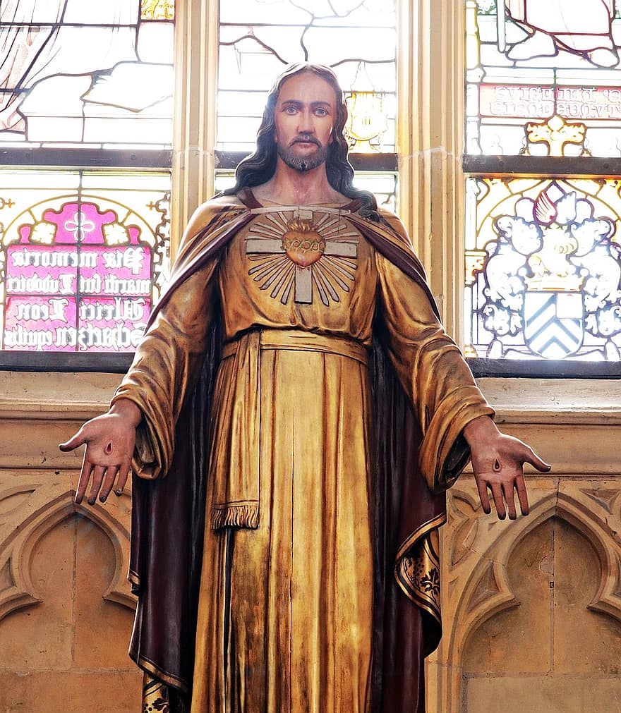
Closing Prayer
Dear God,
Help us to put You first.
Remove all the distractions that stop us from focusing our attention upon You. You are the One who has mercifully loved us and deserves our praise!
Remove the things that separate us from You, and help us to ensure that we are not making anything in our lives more important than You.
Allow us to keep You at the forefront of our minds.
Help us to recognize Your power and majesty in the world around us.
Amen.
Adapted from www.arnoldprays.co.uk

