Slide 1
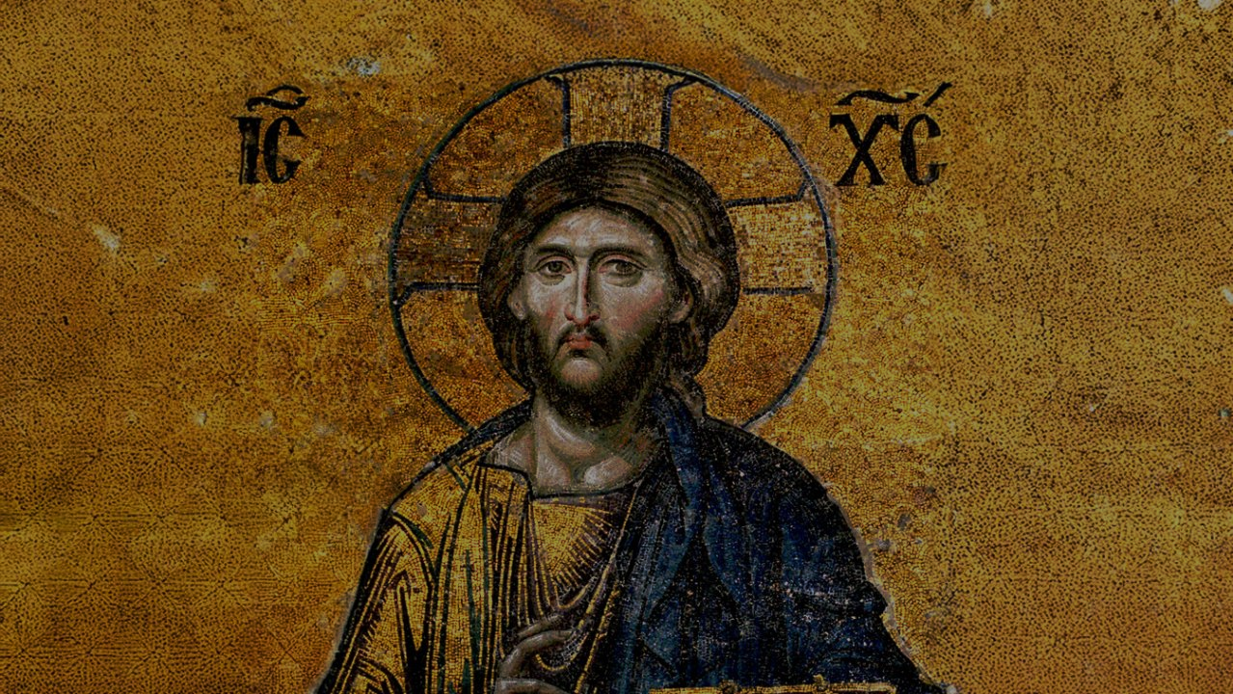
CALLED TO LOVE: THE ADVENTURE OF LIFE IN CHRIST
TOPIC: New Law Fulfills the Old Law
Jesus – The Way, the Truth, and the Life, Sin and Forgiveness, Grace & Christian Holiness

Slide 2
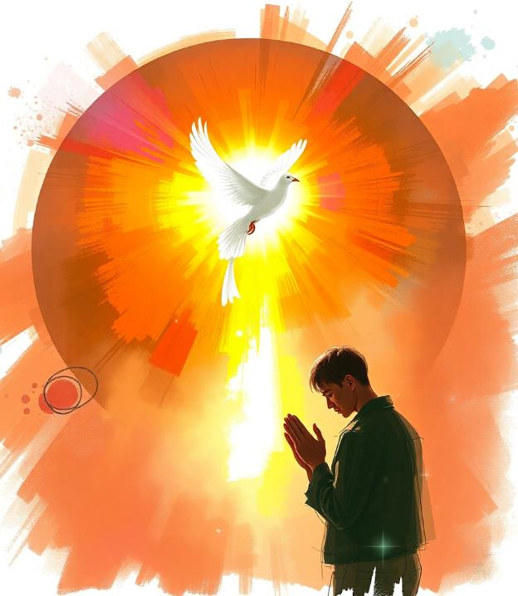
^{Opening Prayer}
Lord Jesus Christ,
We entrust our family to You and ask for Your blessing and protection.
We love You Lord Jesus with all our hearts, and we ask that You help our family to become more like the Holy Family.
Help us to be kind, loving, and patient with one another.
Give us all the grace we need to become saints and Your faithful disciples.
Amen.

Slide 3
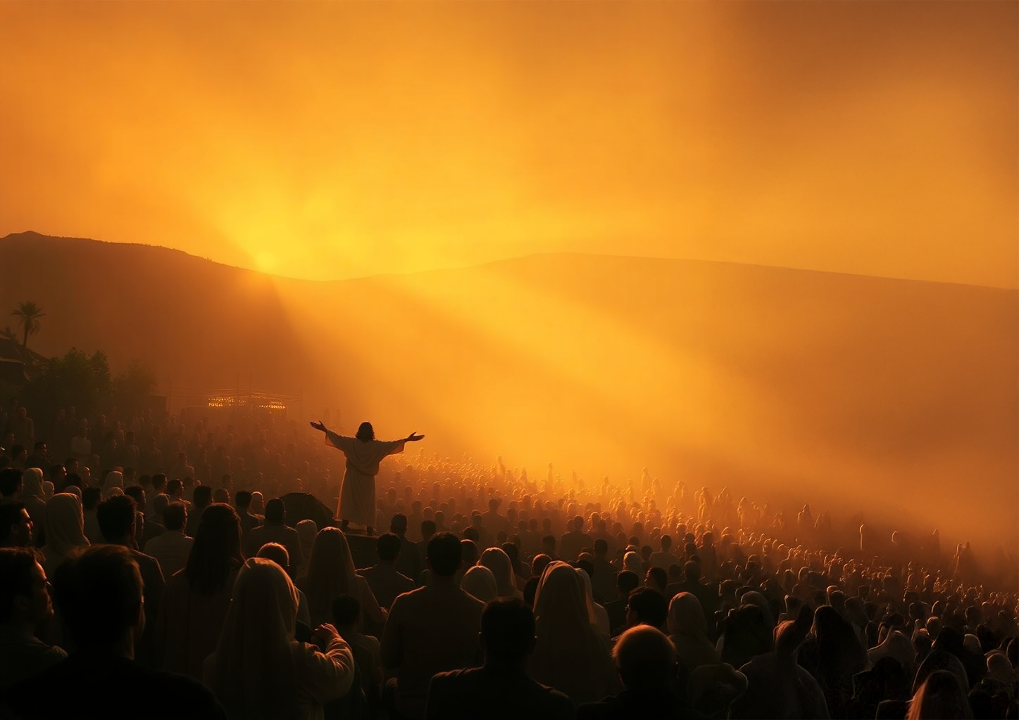
“Blessed are the poor in spirit,
for theirs is the kingdom of heaven.”
“Blessed are those who mourn,
for they will be comforted.”
“Blessed are the meek,
for they will inherit the earth.”
“Blessed are those who hunger and thirst for
righteousness, for they will be filled.”
“Blessed are merciful,
for they will be shown mercy.”
“Blessed are the pure in heart,
for they will see God.”
“Blessed are the peacemakers,
for they will be called children of God.”
“Blessed are those who are persecuted
because of righteousness,
for theirs is the kingdom of heaven.”
“Blessed are you when they insult you and
persecute you and utter every kind of evil
against you [falsely] because of me.
Rejoice and be glad, for your reward will be
great in heaven.”
^{Ice Breaker}
^{Ice Breaker}
Beatitude Charades
Open your bibles to Jesus’ teachings in the Sermon on the Mount (Mt. 5:1-10).
Family members take turns drawing out a piece of paper and silently acting out what’s written on it while the rest of the group tries to guess.

Slide 4
^{Family Sharing}
At home, you discussed how your family will live the Lenten Season together.
How is God calling you to live the three Lenten Pillars of Prayer, Fasting and Almsgiving?
What will you do this Lent to prepare your hearts for Jesus?

Slide 5
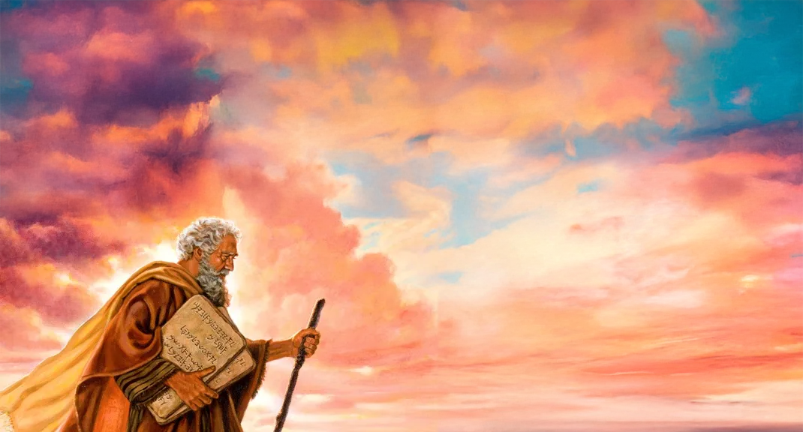
REVIEW
Last month, we learned about the time when the Lord had just freed the Israelites from slavery, and He gave them Ten Commandments. The Ten Commandments were a path of freedom and happiness that taught and reminded the Israelites of the basics of how to love.
The Israelites had made a covenant or sacred agreement with God where the Israelites were supposed to keep God’s commandments and, in return, God would be their God. He would love and protect them as His own children. However, the Israelites were often unwilling to follow the laws and keep the covenant that they had made with God.
But God, who is love, had a wonderful plan!

Slide 6
REVIEW
At Jesus’ first public sermon, the Sermon on the Mount,
Jesus begins by teaching us the Beatitudes
which we learned about at our last gathering.
There Jesus taught the law of the New Covenant,
(the New Law), that expands and fulfills the rules of love that God gave to Moses.
Please open your bibles to Matthew 5:13-7:29.
(Families to take turns reading the sections aloud.)

Slide 7
FAMILY CONVERSATION
Which are the more challenging laws of love,
the Ten Commandments
or
Jesus’ teachings at the Sermon on the Mount?
How/why are those laws of love more challenging?
https://www.youtube.com/watch?v=c299MjqabKk&t=15s

Slide 8
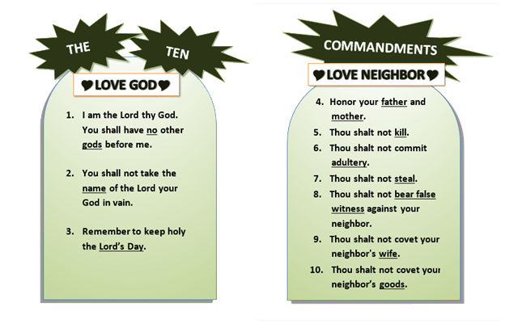
How Our Family follows the 10 Commandments

Slide 9
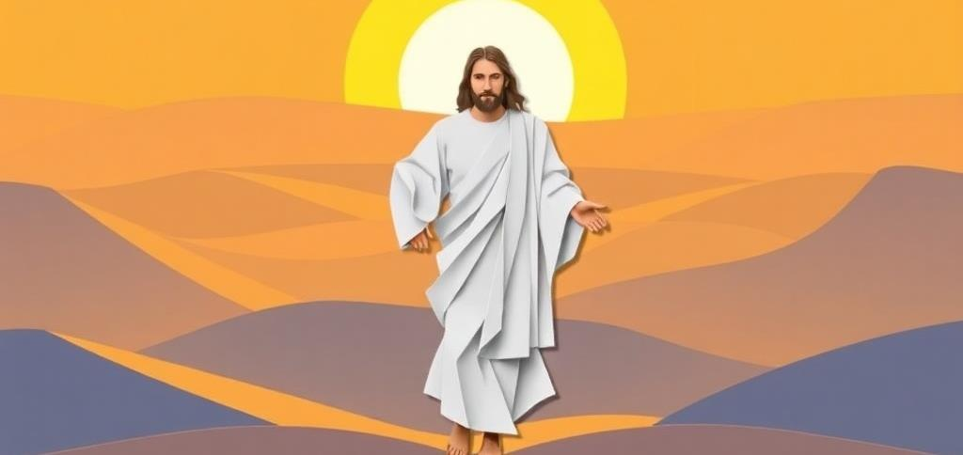
SERMON ON THE MOUNT
As we read in the Sermon on the Mount, the New Law or God’s law of supernatural love that teaches us to love as Christ loves us, is difficult, and basically impossible for us to follow perfectly, relying on our own strength.
However, the Father gave us Jesus, who did not only open the gates of Heaven to us, but also is the Way, the Truth and the Life for us. It is Jesus who gives us the grace to live His Father’s laws of Divine Love!
How does Jesus give us this grace?

Slide 10
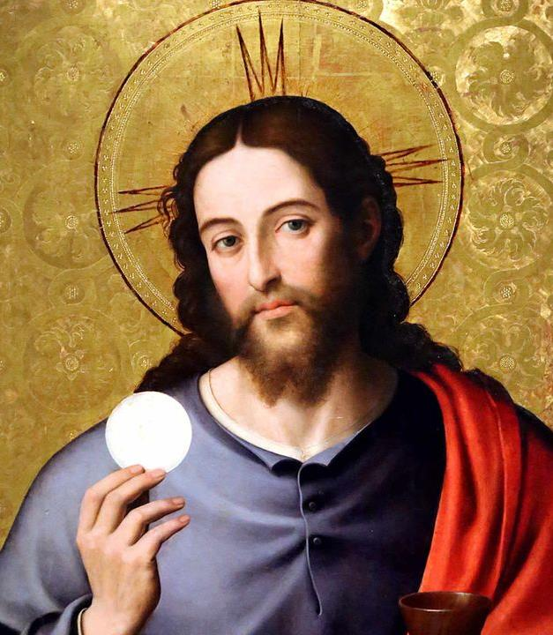
Jesus give us this grace through His Church and the Seven Sacraments!
In particular, at the Last Supper, Jesus instituted the New Covenant through the Sacrament of the Eucharist.
Then He gave His Apostles a New Commandment.
Open your bibles to John 13: 31-35 and read aloud.
When Jesus explained that He must leave the Apostles, they became upset, so Jesus told them how they can find Him.

Slide 11
LAST SUPPER
It is no coincidence that Jesus told His Apostles this at the Last Supper.
Jesus’ sacrifice on the Cross (and Paschal Mystery) is the source of all the graces of all the sacraments.
It is through His sacrifice that we can love God and one another and be reconciled to the Lord over and over.
In this, we find the way to Jesus who is our Way to Heaven.
It is through knowing Jesus that we come to know Truth, so we can live holy lives.
And it is through Jesus and the sacraments that He gave to us, that we know the Life, which is God’s grace!
Only through Jesus can we come to live the New Law, God’s law of supernatural love.
The Holy Trinity is the family that we have been created to become one with.
https://youtu.be/9Y9qCsIPzNo?si=T-ITwDQwG7_5CWWn

Slide 12
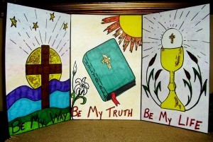
FAMILY ACTIVITY
By the grace of the Holy Spirit, we are able to choose the Lord Jesus and be transformed by the gift of His love!
We are able to live the call to Christian holiness, which is a call for all the baptized, to live a life of discipleship, the adventure of loving others as Christ has loved us.
Jesus is truly the Way,
the Truth
and the Life!

Slide 13
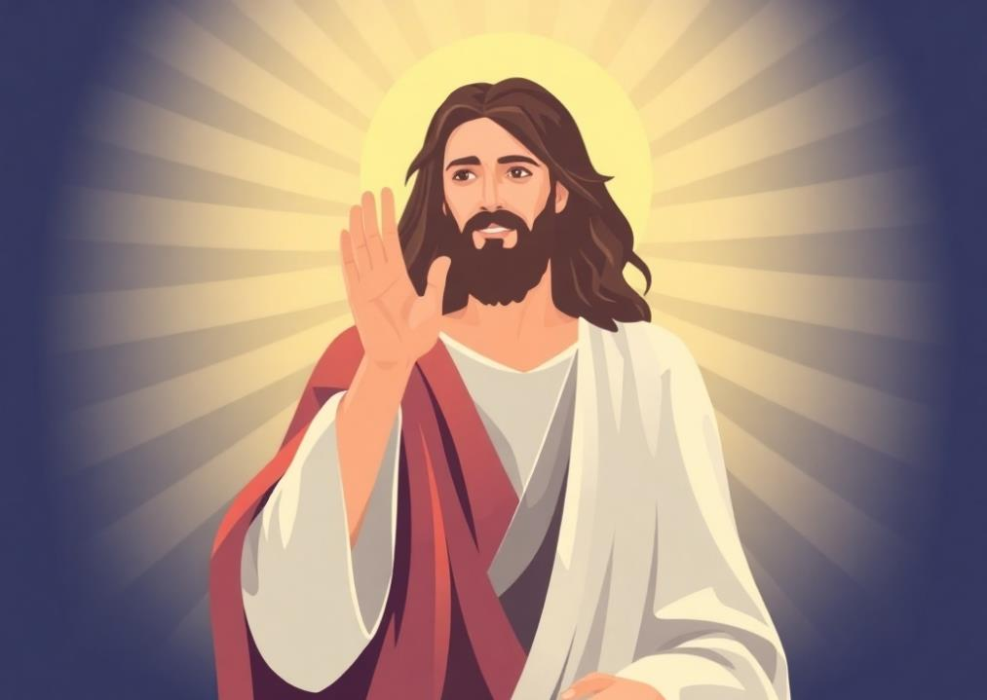
A Beatitudes Prayer
Dear Lord,
Make me poor in spirit, so I can receive the Kingdom of Heaven.
When I mourn, help me find comfort.
Make me meek, so that I may inherit the land.
Help me to hunger and thirst for righteousness, so I may be satisfied.
Make me merciful, so I may obtain Your mercy.
Make me pure of heart, so I may see You.
Help me to make peace, so I may be called Your child.
When I am persecuted for righteousness’ sake, show me Your Kingdom.
We ask this in the Holy Name of Jesus. Amen.
Adapted from www.thereligionteacher.com

