Slide 1
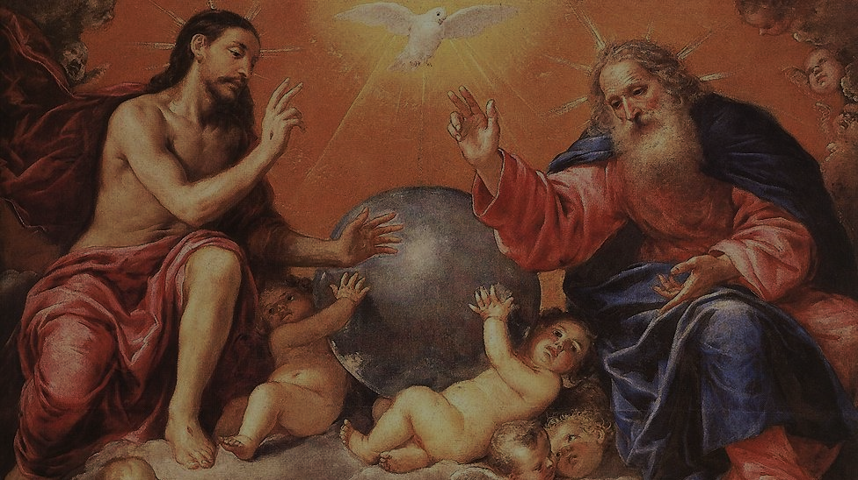
CALLED TO LOVE: THE ADVENTURE OF LIFE IN CHRIST
Topic: The Holy Trinity

Slide 2
THE HOLY TRINITY TOPICS:
The Holy Trinity is Family
God is a Communion of Persons
God is Love
Heaven and Earth
The Gift of Creation
Angels & Fallen Angels

Slide 3
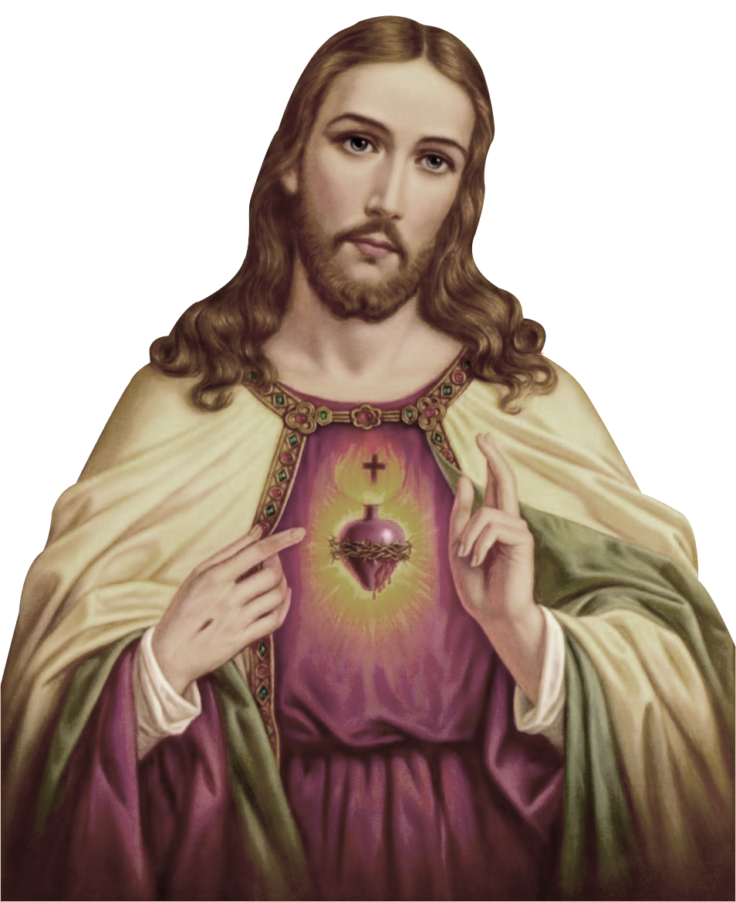
^{Opening Prayer}
Lord Jesus Christ, we entrust our family to You and ask for Your blessing and protection.
We love You Lord Jesus with all our hearts, and we ask that You help our family to become more like the Holy Family.
Help us to be kind, loving, and patient with one another.
Give us all the grace we need to become saints and Your faithful disciples. Amen.
This Photo by Unknown Author is licensed under CC BY-NC

Slide 4
^{Ice Breaker}
SECRET IDENTITY
Everyone secretly writes down the name of a person in the bible or a saint on a small piece of paper or a “post-it” note. It has to be a famous person that everyone in the room would know about.
Then tape the name on the back of the person on your left.
Everyone goes around and asks people yes-or-no questions about who is on his/her back.
You can only ask each person one question.
The person who can do it, in the least number of questions, wins.
Adapted from www.youthgroupgames.com.au
Pope
Francis

Slide 5
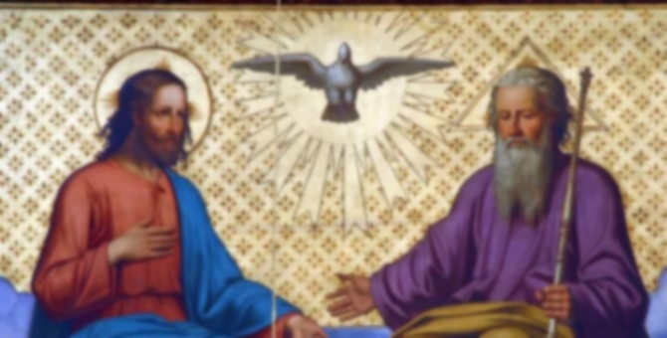
REVIEW
The last time we were together we talked about the Holy Trinity.
What do we believe about the Holy Trinity?

Slide 6
REVIEW
We believe that God is the Holy Trinity, which means He is three Persons in One God: God the Father, God the Son and God the Holy Spirit.
The Holy Trinity is “Family”; a communion of Persons.
God always existed. God is eternal.
He has no beginning and will have no end.

Slide 7
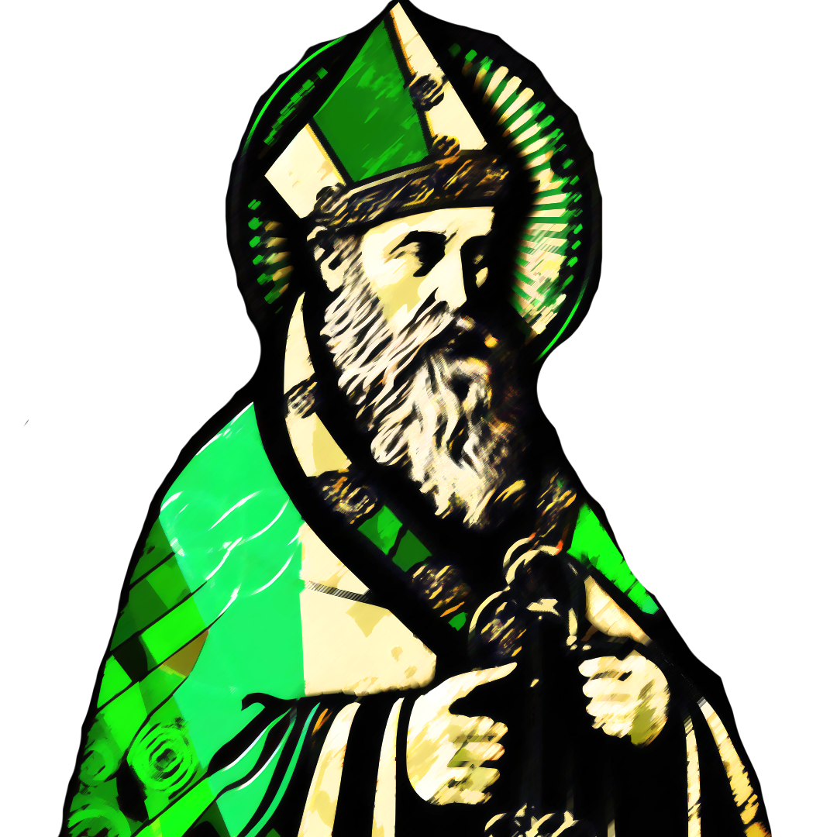
THE HOLY TRINITY
What did St. Patrick used to explain the Holy Trinity?
A shamrock
This Photo by Unknown Author is licensed under CC BY-SA

Slide 8
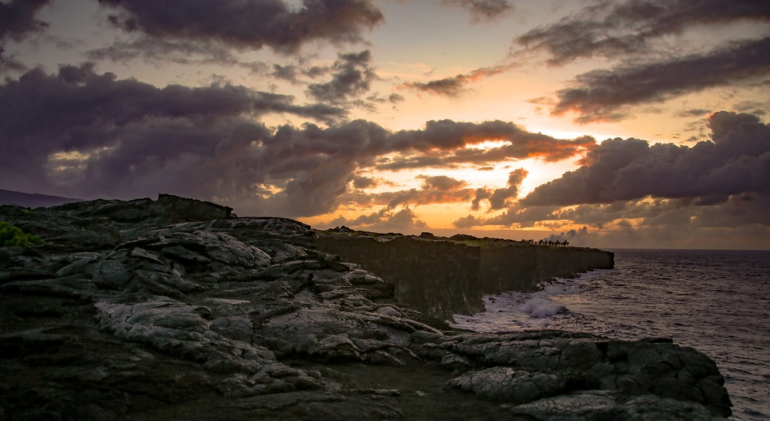
THE HOLY TRINITY
The Holy Trinity is the first Family that ever existed!
The Trinity – God the Father, God the Son and God the Holy Spirit- eternally loved each other and loved being Family so much that the One God decided, out of love, to multiply and grow His family.
So, God created us, human beings, in His own image and likeness, to love and be loved and to be His family!
God knew His family would need a home.

Slide 9
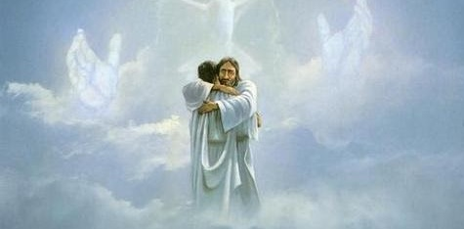
THE HOLY TRINITY
Genesis 1:1 tells us, “In the beginning, when God created the heavens and the earth...”
He created the heavens and the earth as a gift for us, the perfect home for us His family.

Slide 10
WATCH
What are Angels? for Catholic kids
https://www.youtube.com/watch?v=dBfLbeBwltg

Slide 11
WATCH
Revelation 12:7-9
https://www.youtube.com/watch?v=jhXlP5OcR_M

Slide 12
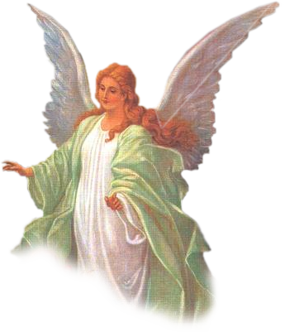
FAMILY CONVERSATION
Every person has a guardian angel.
Do you ask your guardian angel for help?
Do you have a favorite story about an angel perhaps from the Bible,
or from a saint?
The name Michael means, “Who is like God?” Michael asked the angels this question when he was trying to convince the other angels in Heaven to stay with God and not side with Lucifer.
What are some qualities of God that makes Him different than anybody else? With what would you ask St. Michael the Archangel to help you and your family?

Slide 13
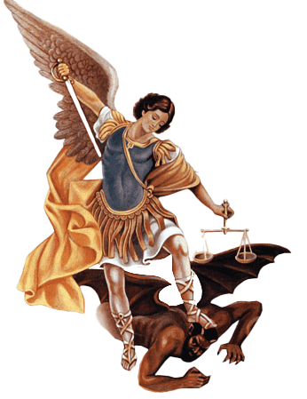
CLOSING PRAYER
St. Michael the Archangel, defend us in battle, be our protection against the wickedness and snares of the devil. May God rebuke him we humbly pray; and do thou, O Prince of the Heavenly host, by the power of God, cast into hell Satan and all the evil spirits who prowl about the world seeking the ruin of souls. Amen.

