Slide 1
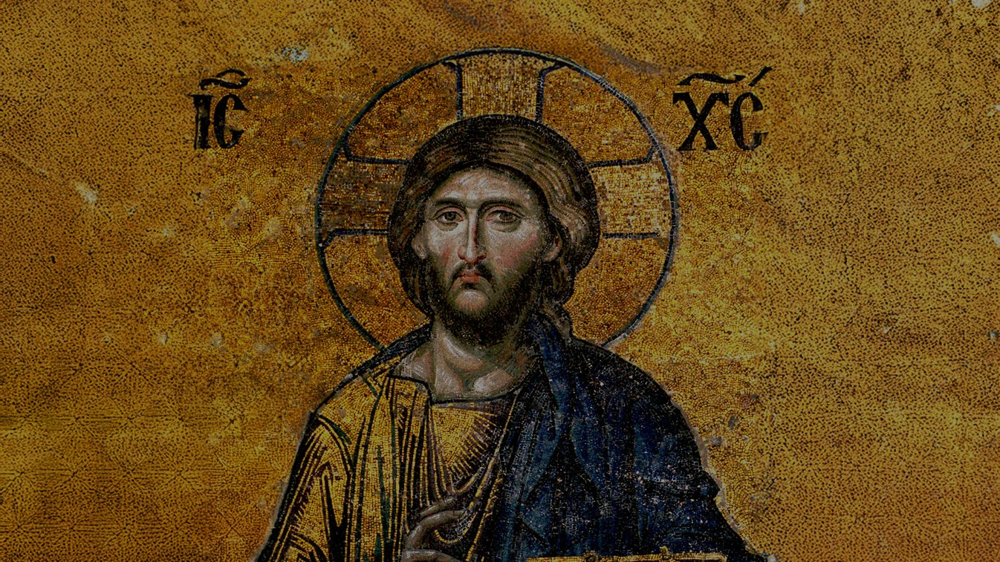
CALLED TO LOVE: THE ADVENTURE OF LIFE IN CHRIST
TOPIC: New Law Fulfills the Old Law Incarnation, God Becomes Man - Beatitudes as the Way of Christ

Slide 2
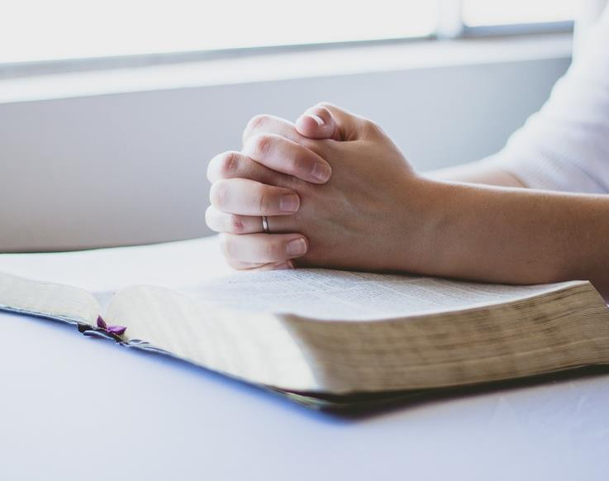
^{Opening Prayer}
Lord Jesus Christ, we entrust our family to You and ask for Your blessing and protection.
We love You Lord Jesus with all our hearts, and we ask that You help our family to become more like the Holy Family.
Help us to be kind, loving, and patient with one another.
Give us all the grace we need to become saints and Your faithful disciples.
Amen.

Slide 3
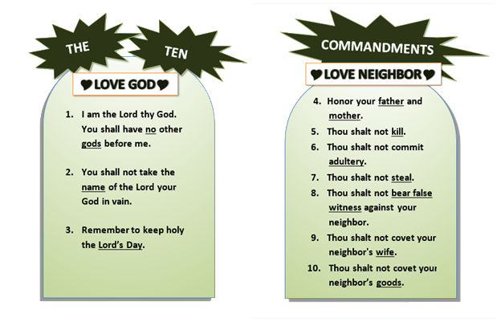
^{Ice Breaker}
Ten Commandments Charades
Family members take turns drawing out a piece of paper and silently acting out what’s written on it, while the rest of the group tries to guess!

Slide 4
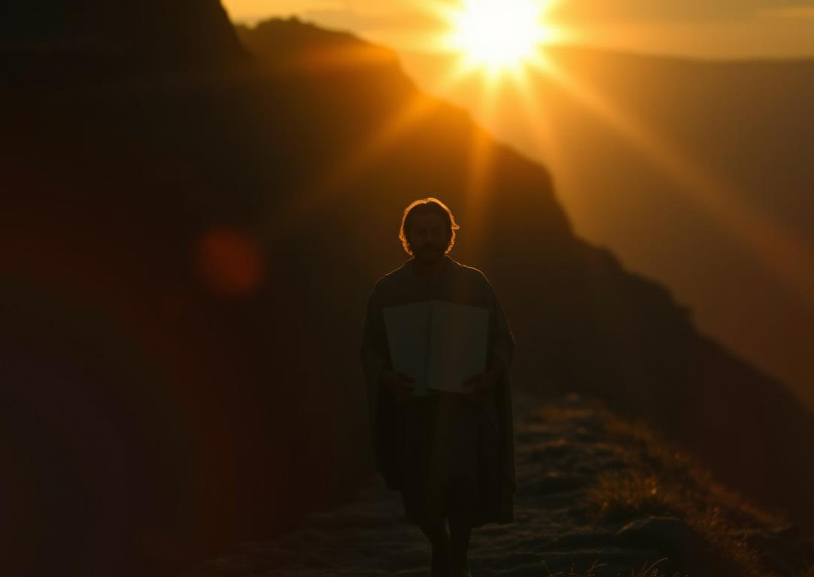
REVIEW
Last month, we learned about the time when the Lord had just freed the Israelites from slavery, and He gave them Ten Commandments. The Ten Commandments were a path of freedom and happiness that taught and reminded the Israelites of the basics of how to love.
The Israelites had made a covenant or sacred agreement with God where the Israelites were supposed to keep God’s commandments and, in return, God would be their God. He would love and protect them as His own children. However, the Israelites were often unwilling to follow the laws and keep the covenant that they had made with God.
But God, who is love, had a wonderful plan!

Slide 5
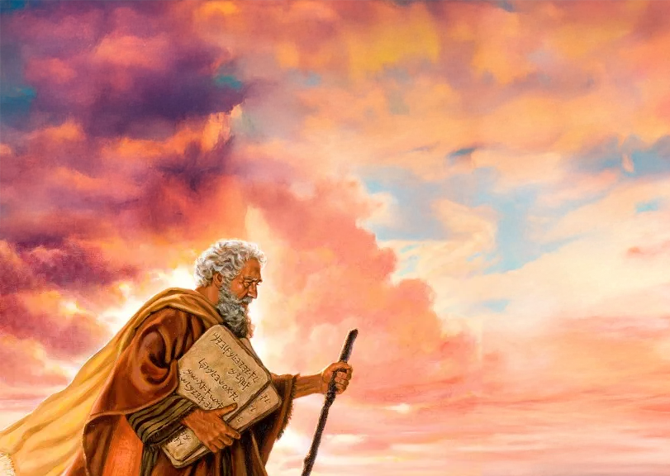
Jerimiah 31:31-34
“The days are coming, says the Lord, when I will make a new covenant with the house of Israel and the house of Judah.
It will not be like the covenant I made with their fathers the day I took them by the hand and led them forth from the land of Egypt; for they broke my covenant and I had to show myself their master, says the Lord.
But this is the covenant which I will make with the house of Israel after those days, says the Lord. I will place my law within them, and write it upon their hearts; I will be their God, and they shall be my people. No longer will they have need to teach their friends and kinsmen how to know the Lord.
All, from least to greatest, shall know me, says the Lord, for I will forgive their evildoing and remember their sins no more.”

Slide 6
Who will make the New Covenant through which all people may know the Lord
and through which
God will forgive their evildoing and
remember their sins no more?
JESUS

Slide 7
WATCH: Bite Size Catholic; Incarnation
https://youtu.be/XCljcyKW8CY?si=IgptgC5K3MFEjz2-

Slide 8
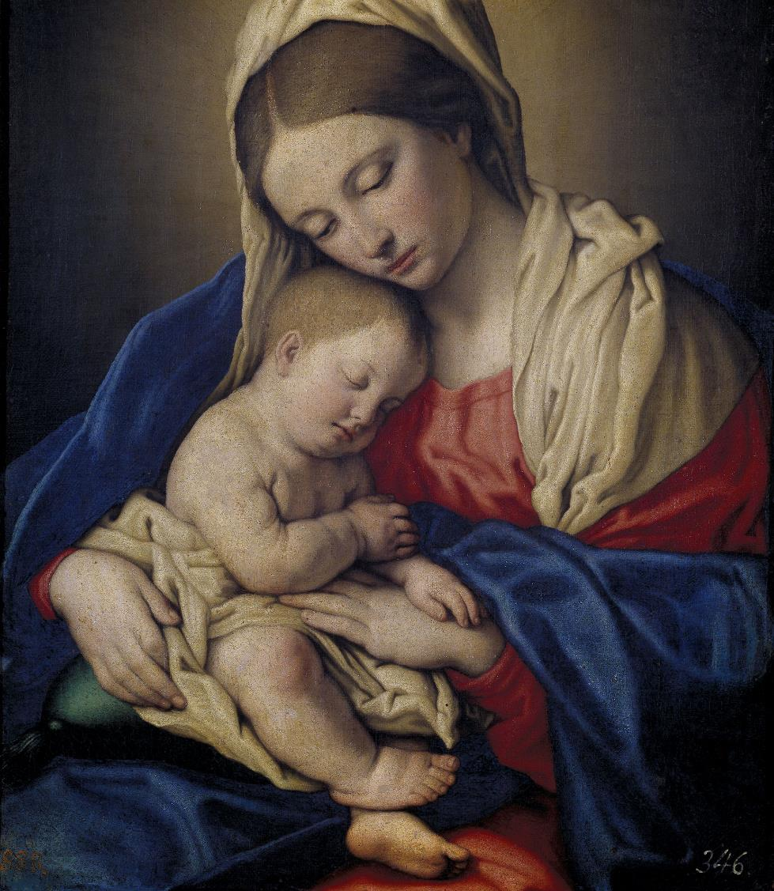
THE INCARNATION
The Incarnation is when “the Son of God was made ‘flesh’ and became truly man, “body and soul like us, to save us.” (Jn 1:14 & CCCC, no. 86)
God would teach all people true love through His own sacrificial love for us!
The Father gave us His Son, Jesus, to teach us how to love through His words, His actions, and most powerfully, in the laying down of His life for us.
Even more, not only did Jesus teach us to love, but by His love poured out for us, He rescued us from sin and gave us the grace to love God, others and ourselves.

Slide 9
The Sermon on the Mount
In Jesus’ first public sermon, the Sermon on the Mount, Jesus expands and fulfills the Old Law of love that God gave to Moses.
He begins this sermon by teaching us the Beatitudes.
https://youtu.be/o5OnF3sg0cY?si=mRaw6dupxooscKR7

Slide 10
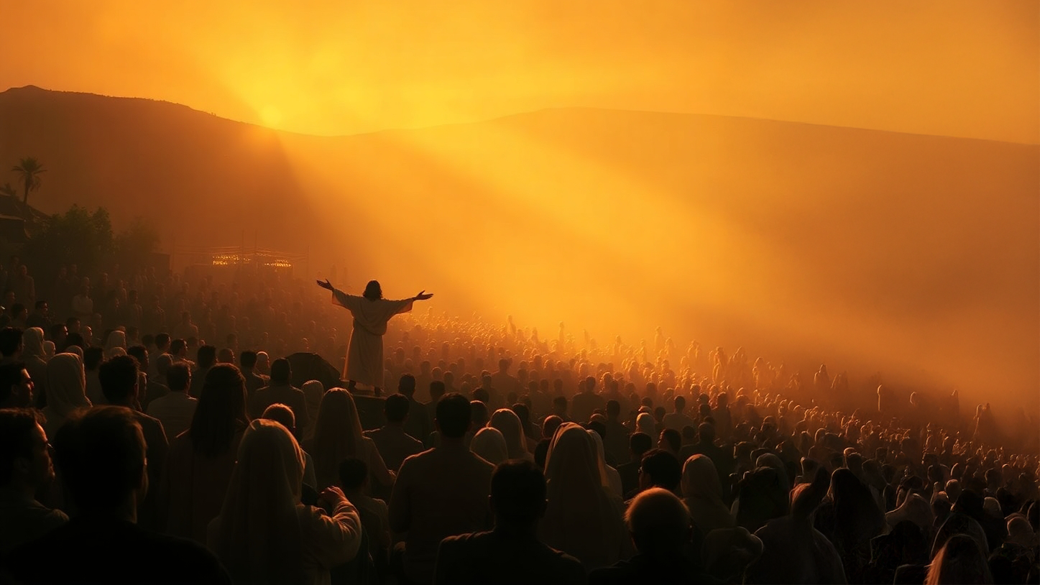
Matthew 5:1-12

Slide 11
In the Old Testament, each covenant that the Israelites made with God came with a promise. For example, see Genesis 12:1-3, when God made the covenant with Abraham.
God said that if Abraham kept the covenant, God would fulfill His promise and give Abraham many descendants, land, and they would become a blessing to the whole world!
For each Beatitude or blessing, Jesus also makes a promise!

Slide 12
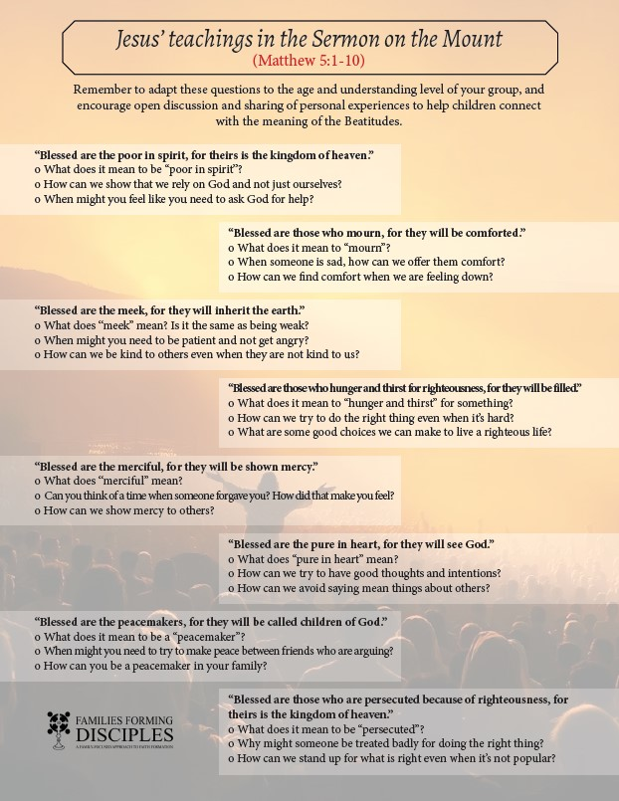
FAMILY CONVERSATION & ACTIVITY

Slide 13
MISSION ACTIVITY
Your Family At-Home Mission is to:
Watch the videos about the Incarnation and the Sermon on the Mount.
As a family decide how you will live the Lenten Season together. Be prepared to share your plan at the Week 3 gathering.
Consider the three Lenten Pillars of Prayer, Fasting and Almsgiving as you ask God how He wants your family to prepare your hearts for Jesus.
iii. Gather as a family around your home altar and pray a Divine Mercy Chaplet, or Watch and pray with Divine Mercy Chaplet by The Catholic Crusade.

Slide 14
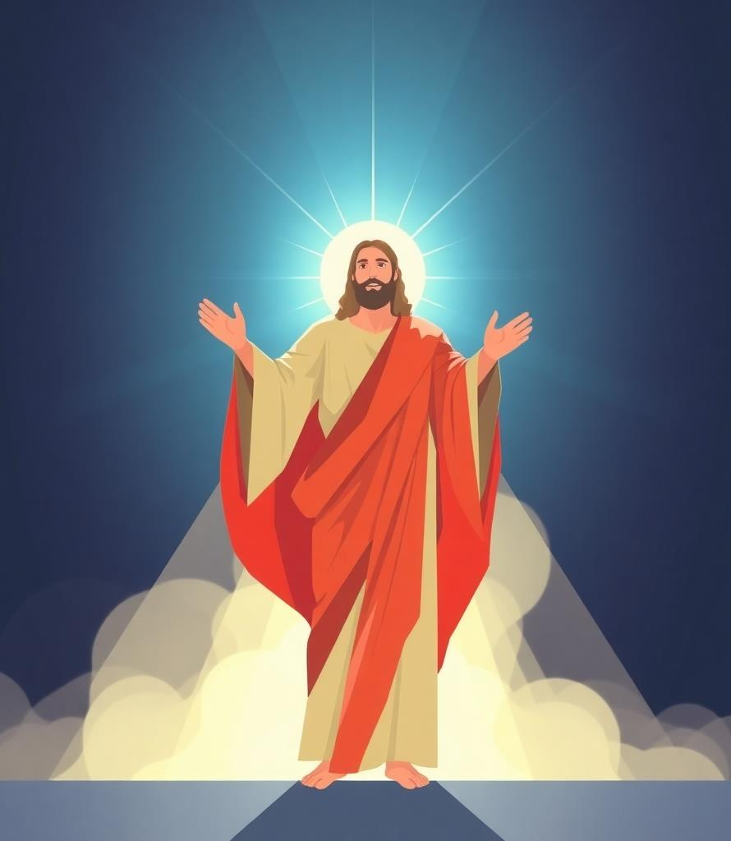
Closing Prayer
Lord Jesus,
Help our families to always remember that our true happiness comes from following Your path of righteousness, for You are the Way, the Truth and the Life.
Lord, teach us to be humble in all our ways, to put others before ourselves, and to recognize that true greatness lies in serving others with a loving heart.
Open our eyes to see the love that You have for each of us.
Give us the courage to let that love transform us to live in Truth.
As we do our best to walk the way You have laid out for us, help us when we struggle to love those around us. Help us to keep our eyes on You and the eternal life You promise to those who seek You.
May we encounter the truth and life that service brings as we serve and let ourselves be served and loved.
In Jesus’ name, Amen.
Adapted from www.catholic.org and www.commongrace.org

